Slide 1
Digital Skills Hub
Foundations - Lesson 1

Slide 2
Lesson 1 Agenda
Welcome and Introductions
Purpose of this Course
Out of the Box
Course Requirements
Technology Use
Pre-Survey
Email

Slide 3
Welcome and Introductions

Slide 4
Welcome!
Introduce Yourself
Name
Share one fact about yourself
Why this class? What do you want learn?

Slide 5
Today’s Goals
Goals
To become familiar with one another and the course.
To get to know your device and how it operates.
To create a Google Account.
To begin the evaluation process and take the pre-survey

Slide 6
Purpose of this Course

Slide 7
Welcome to the Digital Skills Hub!
This program is here to help you learn the digital skills you need to feel confident using technology in your daily life.
The Digital Skills Hub is a community effort, supported by the City of Columbus and Franklin County, to make sure everyone has the opportunity to keep up with today’s digital world.
We’re excited to have you here and help you build the skills that will make technology easier to use and more helpful for you!

Slide 8
Importance of Digital Skills in Today's World
Digital skills help you get ready for jobs by giving you the tools to succeed in a world where technology is everywhere.
These skills also make it easier to use important online services, like banking, healthcare, education, and staying connected with friends and family.
By learning these skills, you’ll be able to fully participate in today’s society and feel more included, connected, and empowered in a world that’s always changing.

Slide 9
Alternative Activities
While the content in this course is best suited for beginners, additional activities for students with intermediate digital skills are included.
The arrow icon indicates an activity that can be completed independently by those with advanced digital skills.
Links to these activities can be found in the daily email or by typing the URL into your browser.
Example:
Alternate Activity
Explore accessibility features on Chromebook.

Slide 10
Accessing Course Resources
Go to www.gmail.com.
Log in with your username and password.
Click on email from instructor with subject line “DSH Day ”
Click on the activity title in blue.
OR
Enter in the URL from the presentation slides into your browser

Slide 11
Course Requirements

Slide 12
Requirements
Attendance: Must attend all sessions
Survey: Take the Pre- and Post-Survey
Final Showcase: Show one thing you learned in the course
DATE | TIME | HOURS
(e.g. Tues Nov. 12) | xx-xx pm | x hours
— | xx-xx pm | x hours
— | xx-xx pm | x hours
— | xx-xx pm | x hours

Slide 13
Discussion - Norms
What expectations do we want for our class?

Slide 14
Technology Use
What devices do you have at home and what applications/websites do you use most often?

Slide 15
Out-of-the-Box

Slide 16
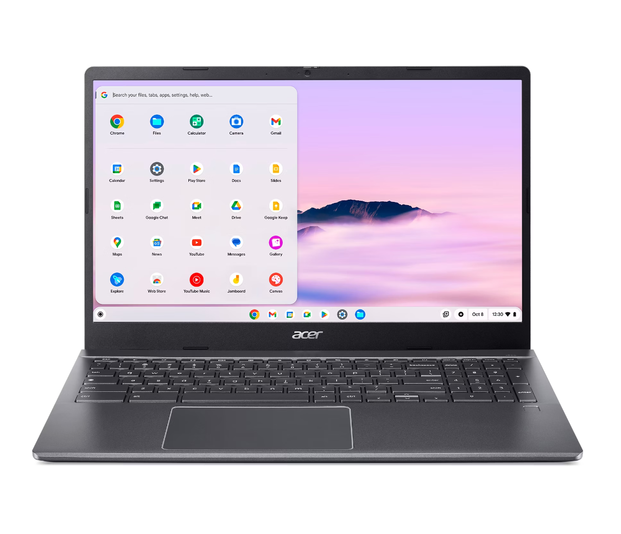
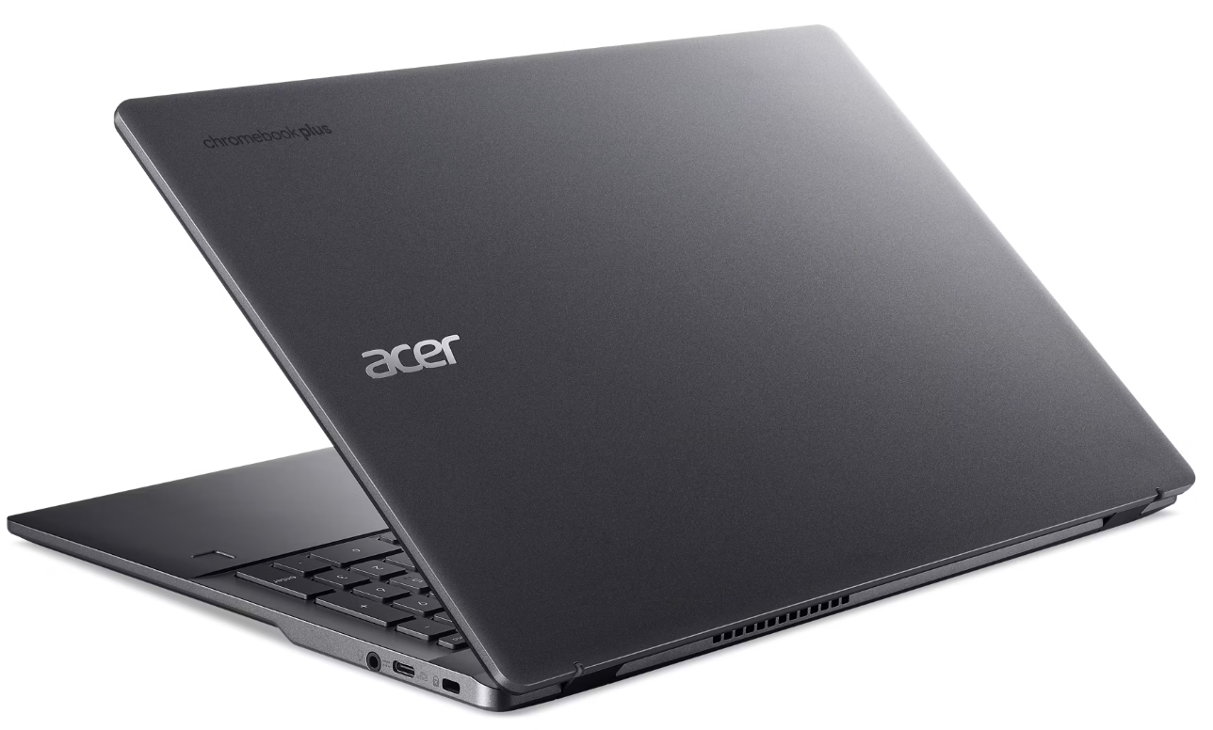

Slide 17
Know Your Device
Left View
USB Type-C port with DC-in Connects to the provided USB Type-C power adapter and to USB devices with a USB Type-C connector. Supports DisplayPort™ over USB-CT™. | HDMI port Supports high-definition digital video connections. | USB port Connects to USB devices. | Battery indicator Indicates the Chromebook's battery status. Charging: The light shows amber when the battery is charging. Fully charged: The light shows blue when in AC mode.

Slide 18
Know Your Device
Right View
Headset/speaker jack Connects to audio devices (e.g., speakers, headphones), or a headset with microphone. | USB Type-C port with DC-in Connects to the provided USB Type-C power adapter and to USB devices with a USB Type-C connector. Supports DisplayPort™ over USB-C™. | Kensington lock slot Connects to a Kensington- compatible security lock.

Slide 19
Know Your Device
Front View
Microphone Internal microphone for sound recording.
Webcam shutter Slide the shutter to the left to cover the webcam. Slide right to open it.
Webcam Web camera for video communication. A light next to the webcam indicates that the webcam is active.
Screen Displays Chromebook output, supports touch or non-touch option.

Slide 20
Know Your Device
Keyboard view
Power button Turns the Chromebook on and off.
Numeric keypad A separate keypad for numeric data entry.
Fingerprint reader Fingerprint reader for unlocking your Chromebook.
Keyboard For entering data into your Chromebook.
Touchpad / click button | Touch-sensitive pointing device which functions like a Chromebook mouse. Pressing down anywhere on the pad functions like the left button of a mouse. Pressing down anywhere with two fingers functions like the right button of a mouse.

Slide 21
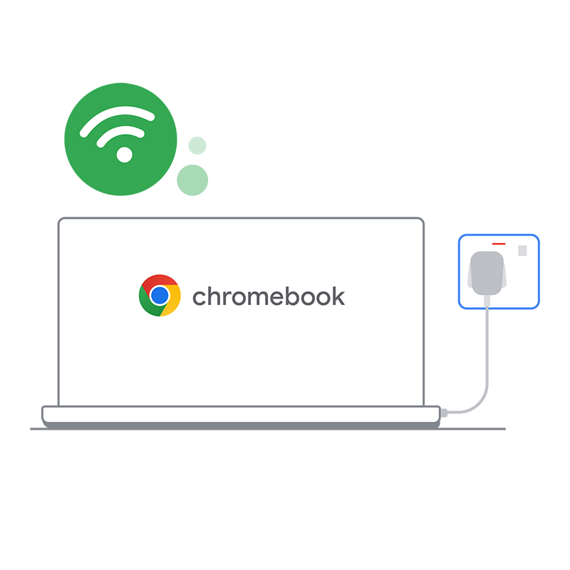
Getting started with your Chromebook
To set up your Chromebook, you'll need:
Your Google Account username and password
Access to internet (WiFi)

Slide 22
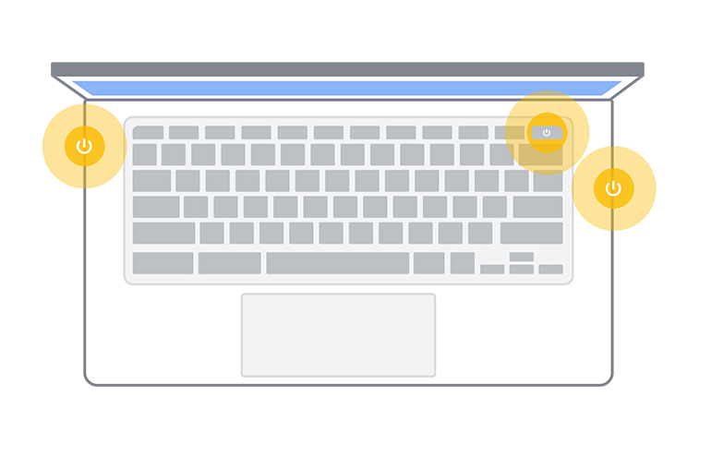
Turn on your Chromebook
Turn on your Chromebook
Plug your Chromebook into a power source. You should be able to find a circular port, typically found on the sides, to plug your charging cable into.
On the keyboard of your Chromebook, find and press the Power button.

Slide 23
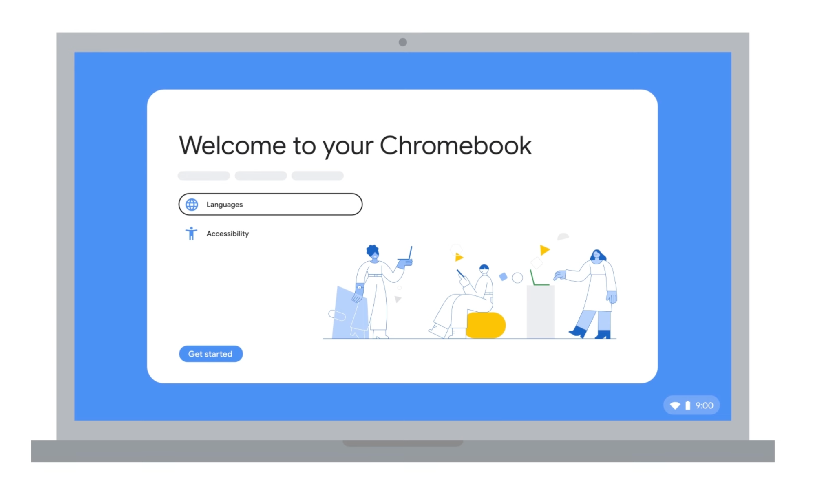
Select your language and click “Let’s go”
Follow the on-screen instructions
To choose your language and keyboard settings, select your preferences from the on-screen options.

Slide 24
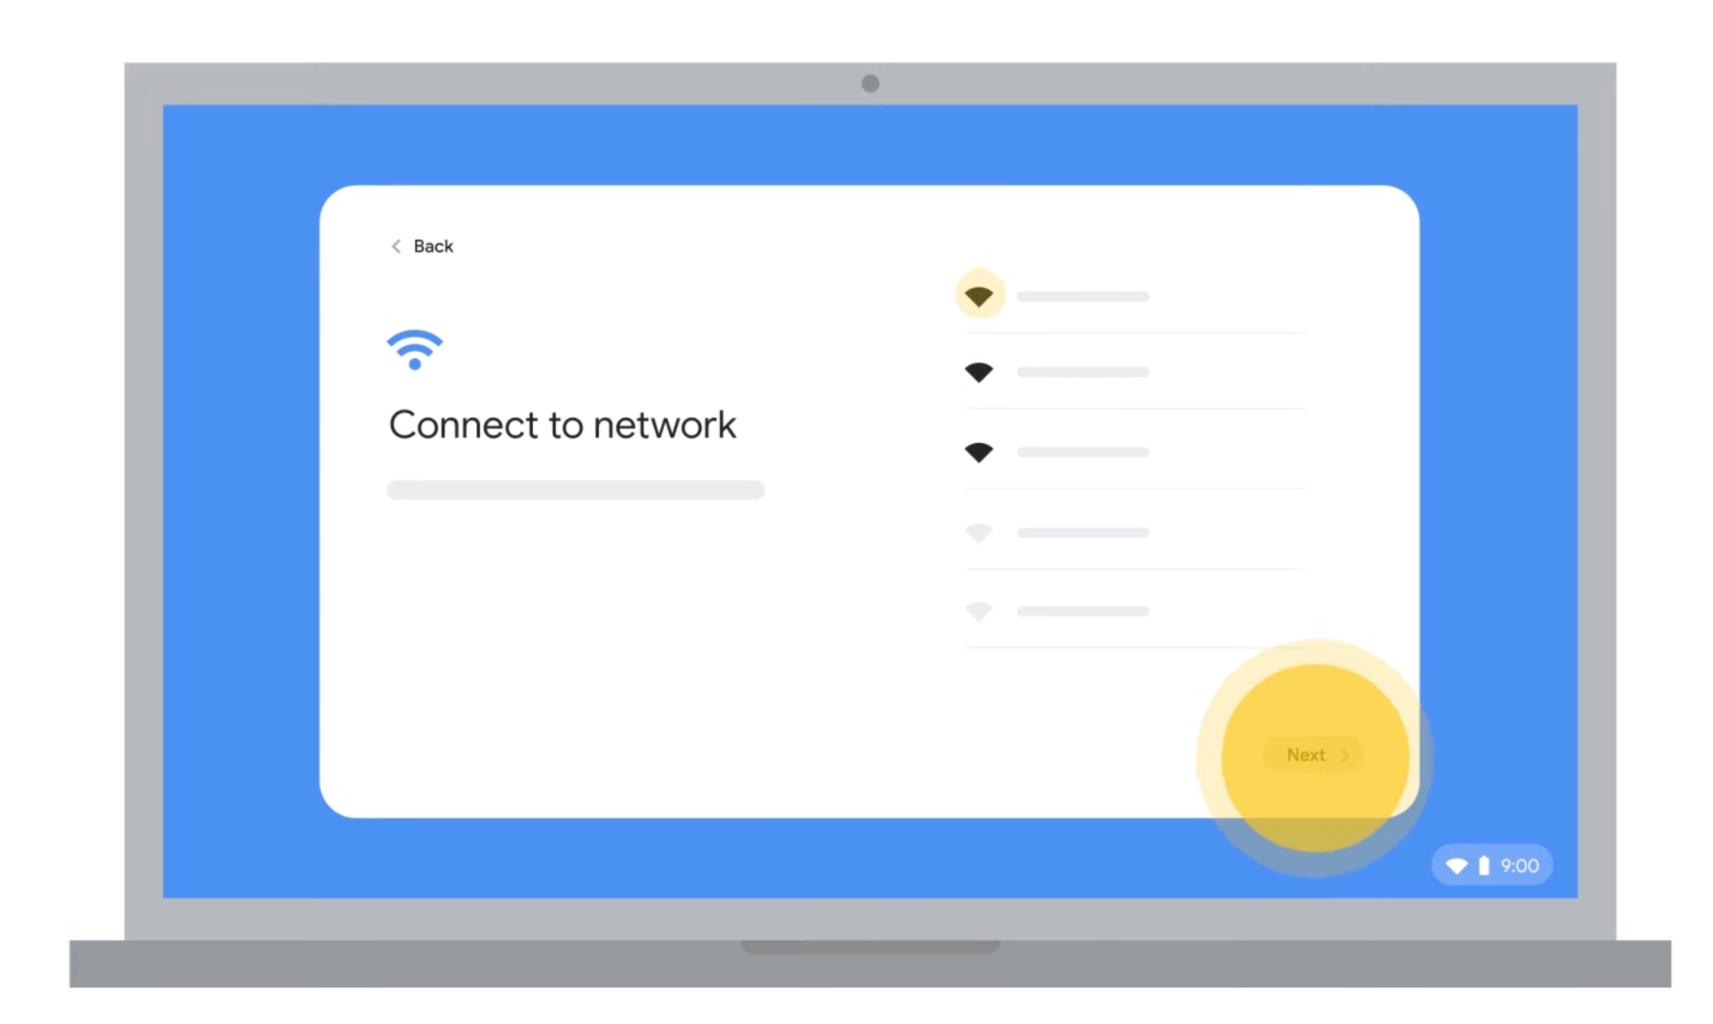
Connect to WiFi
Follow the on-screen instructions
Select your network (WiFi).
Accept the terms of service.

Slide 25
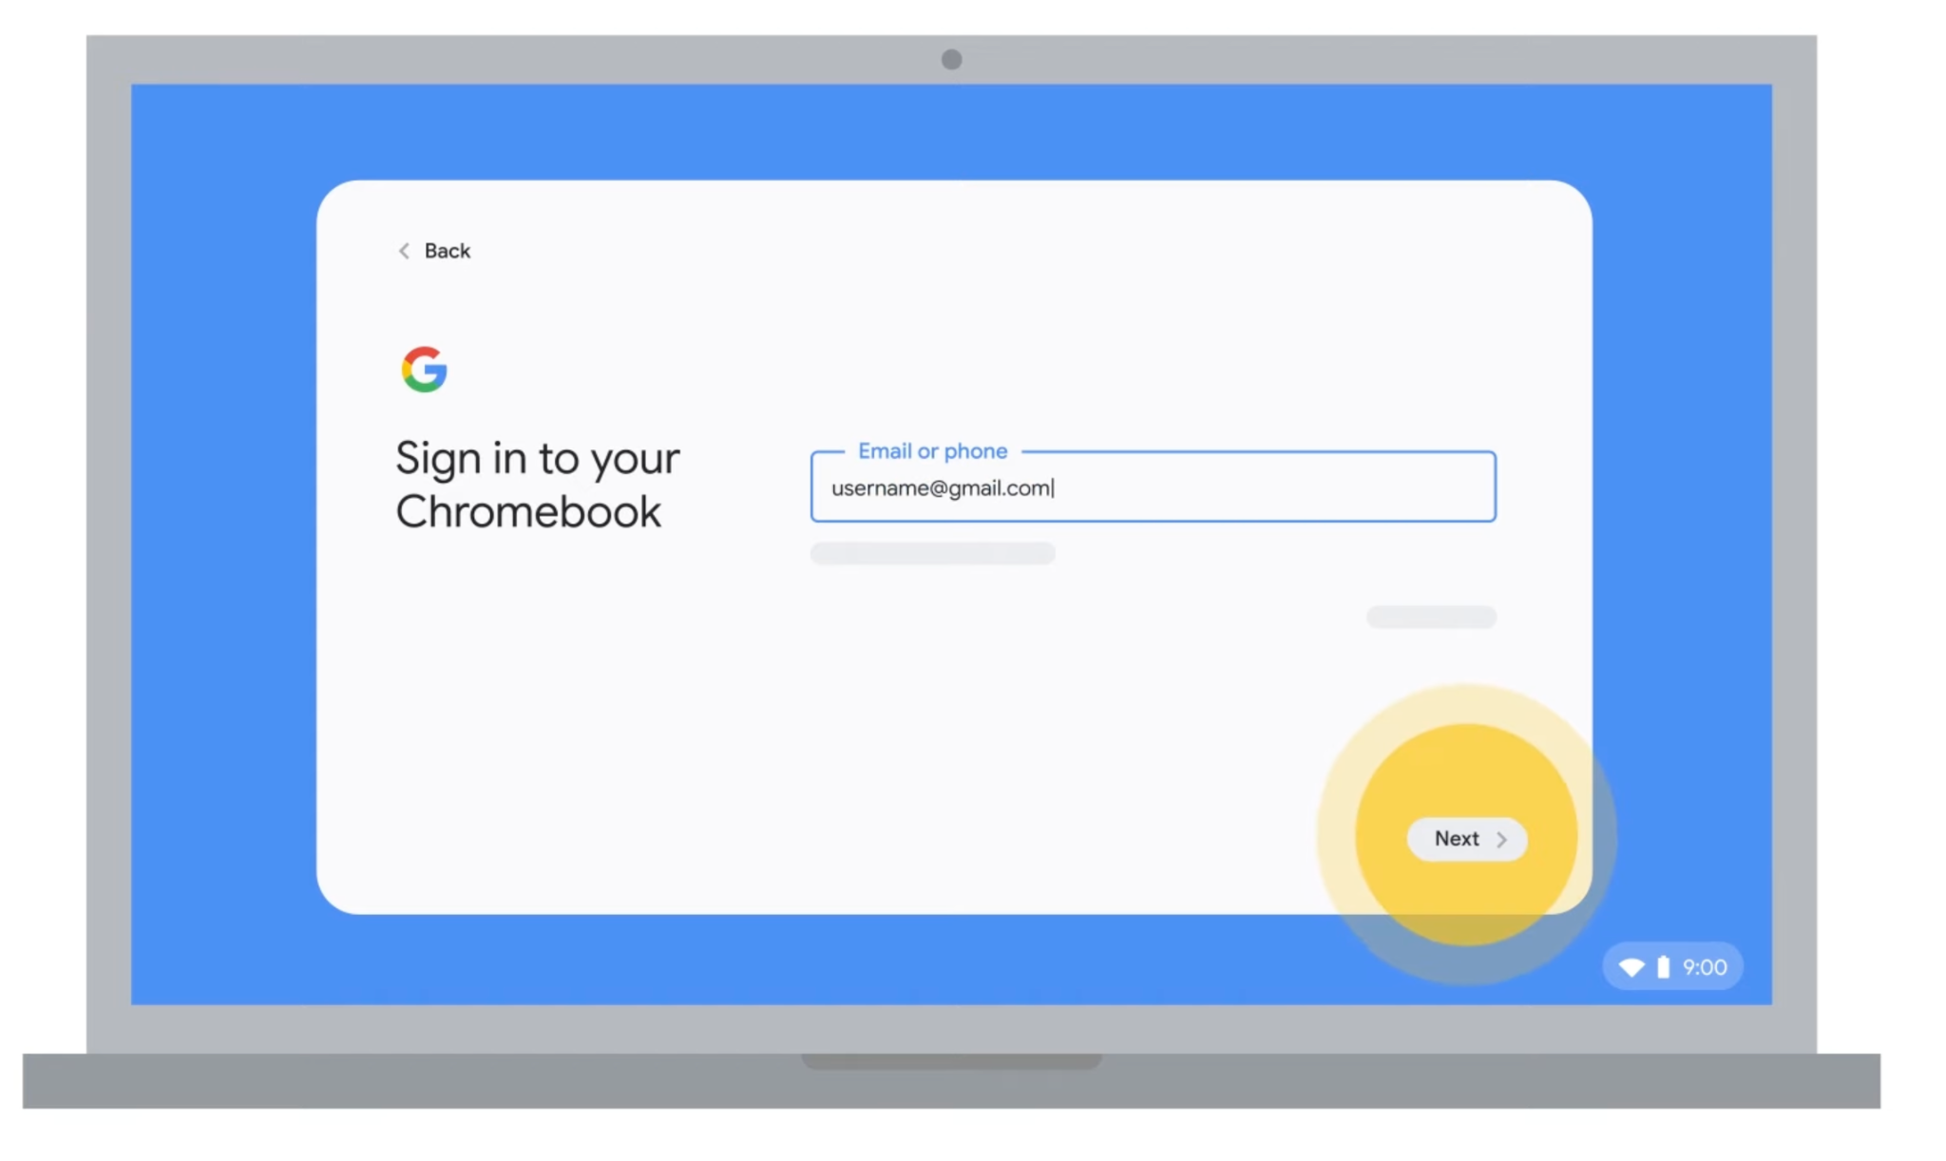
Sign in with your Google Account
Enter your Google Account email and password.

Slide 26
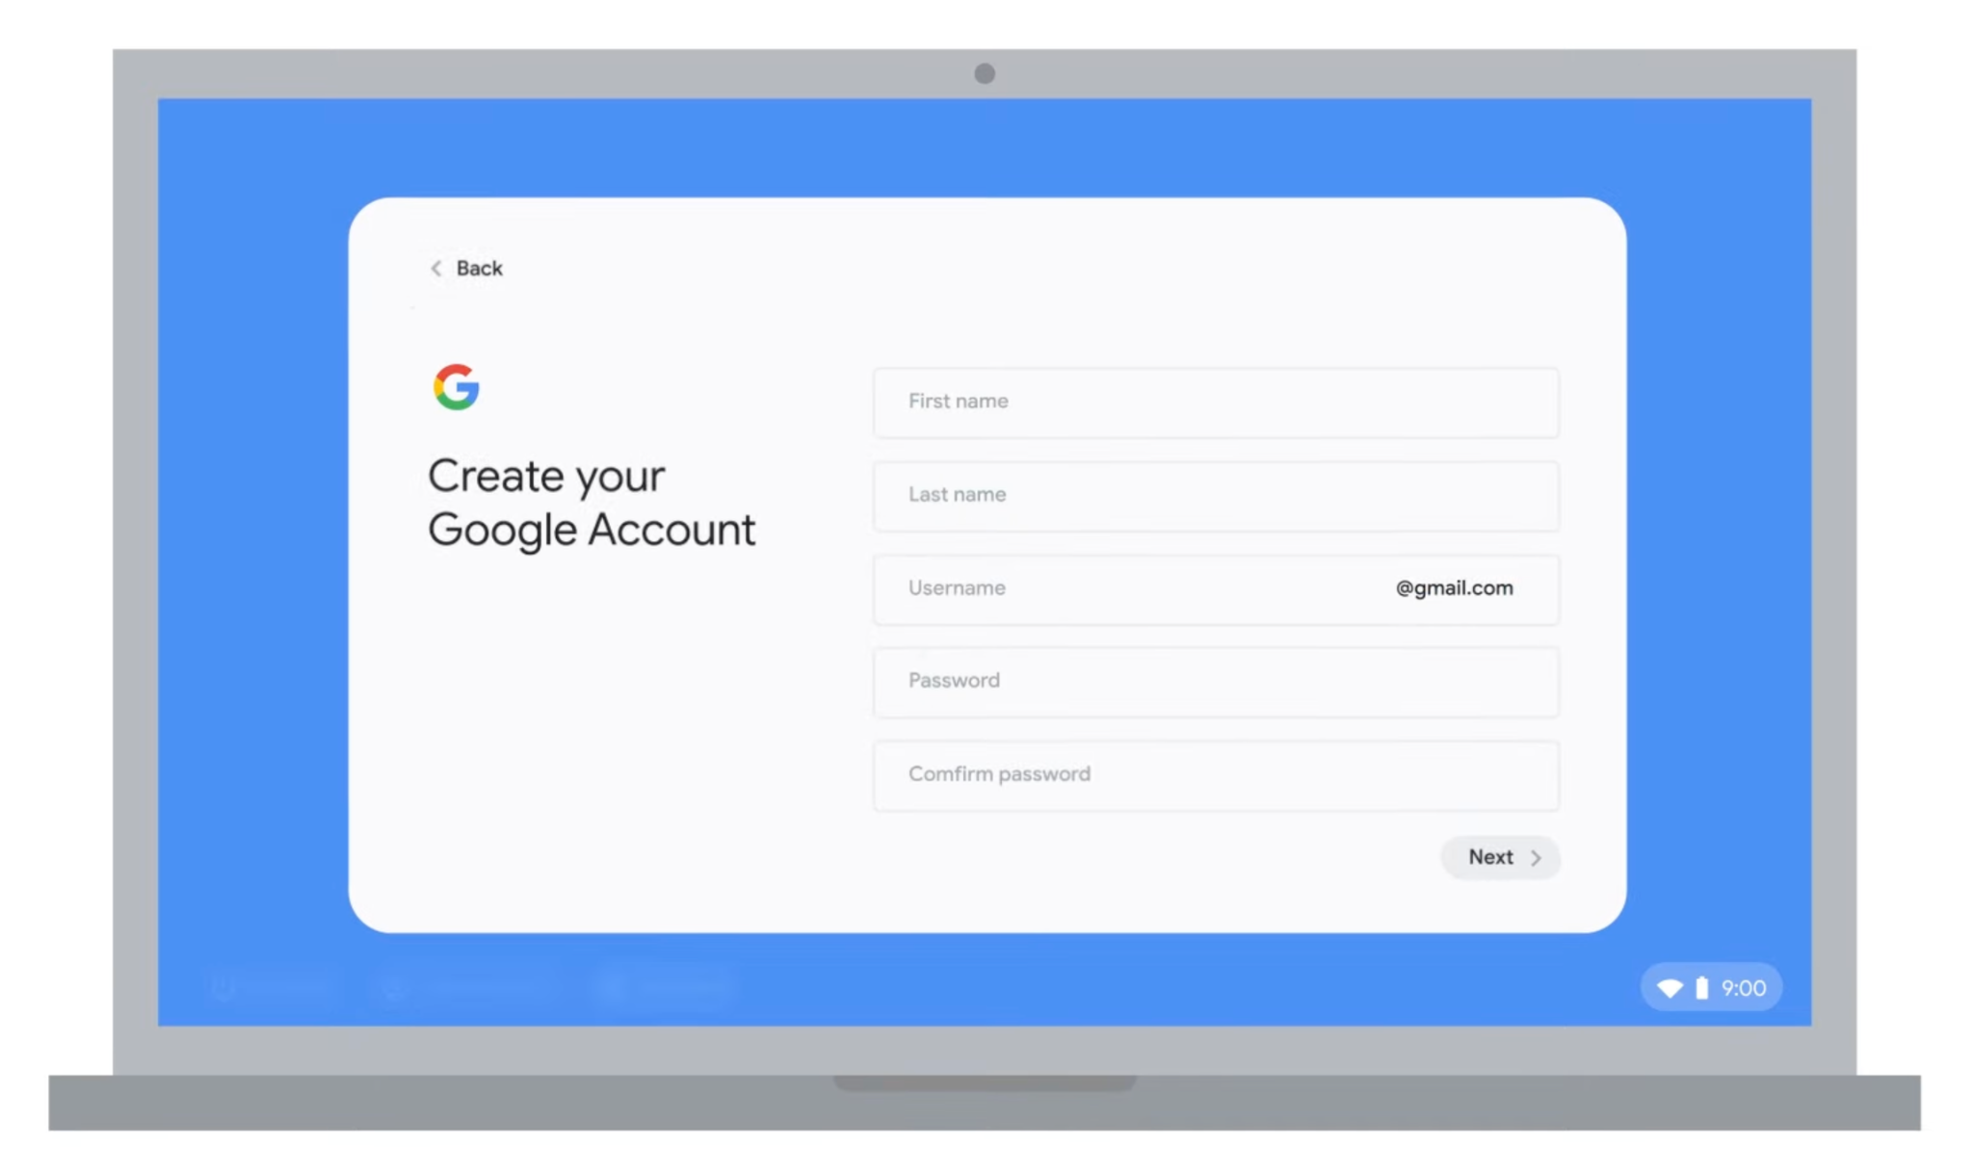
If you don't have a Google Account
If you don’t have a Google Account , click “More Options” and tap on “Create New Account.”

Slide 27
Creating a Google Account
Choosing a Username
Used to communicate with others
Be appropriate
Make take a few tries to find a unique one
Choosing a Password
Something that has numbers, letters, and symbols
Nothing too easy to figure out like ABC123

Slide 28
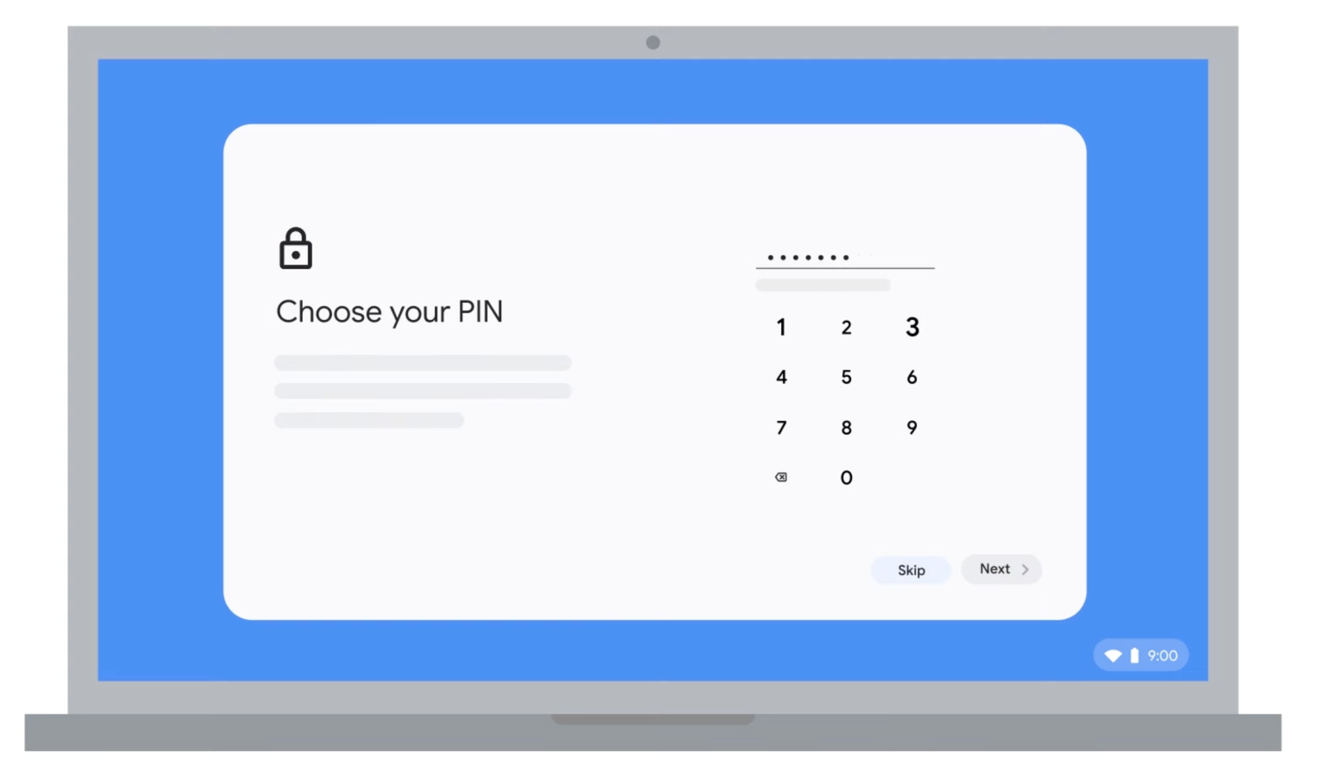
Create a PIN (optional)
You can create a PIN to unlock your Chromebook if you want. A PIN is a numerical code that you can use as an alternative to your Google Account password.
Enter a PIN of 6 digits or more.

Slide 29
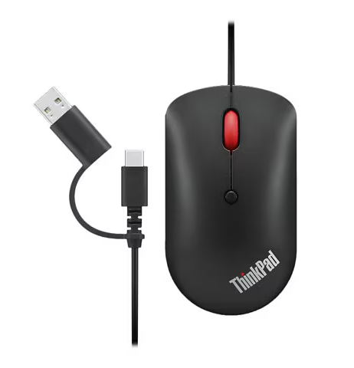
Attach Accessories
Connect your mouse to your Chromebook. Use one of the USB Type-C ports on the sides to connect the mouse cable.

Slide 30
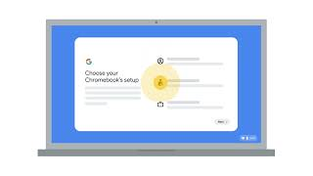
Chromebook Set-up (Video)

Slide 31
Chromebook Interface

Slide 32
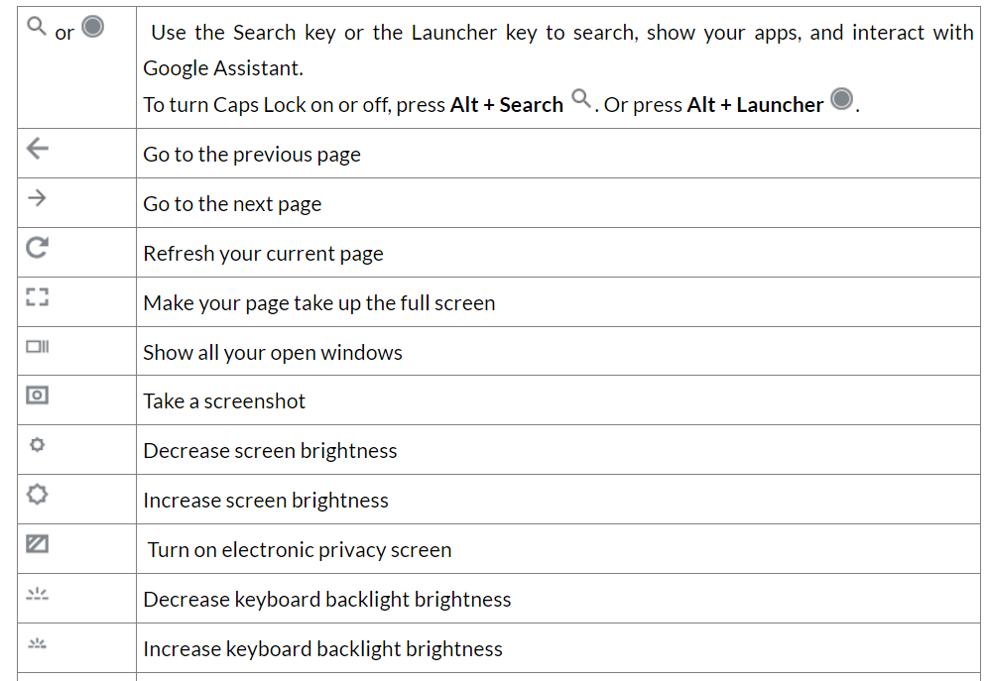
Chromebook Keyboard
Alternate Activity
Explore accessibility features.
tinyurl.com/DSHaccess2

Slide 33
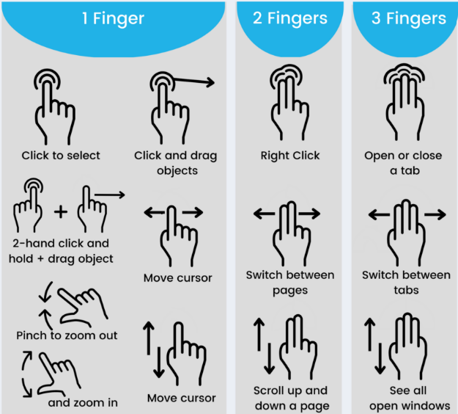
Trackpad Gestures
Chromebook simulator tool: Chromebook Simulator - Use your touchpad

Slide 34
Using a Computer Mouse

Slide 35
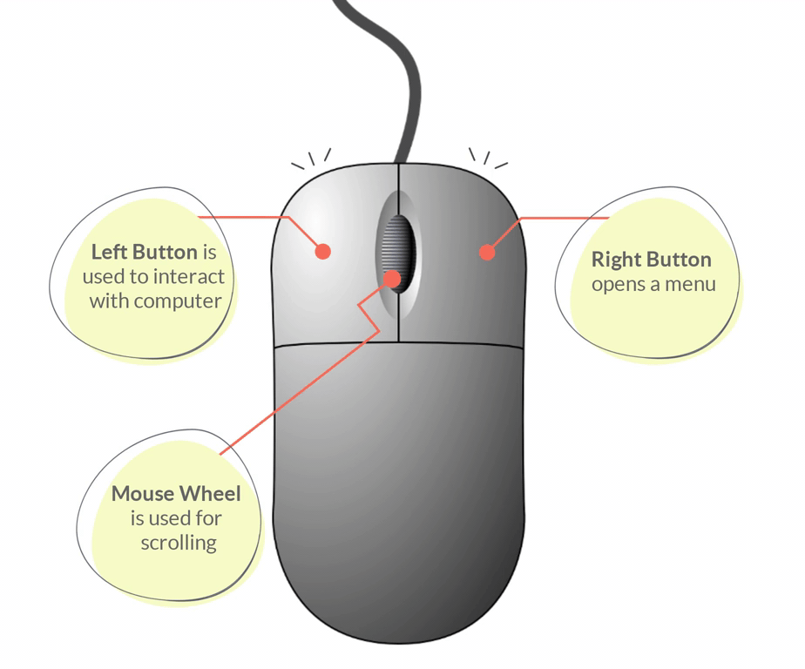
Using a Computer Mouse
Other mouse resources:
Mouse Tutorial
Mouse Exercises

Slide 36
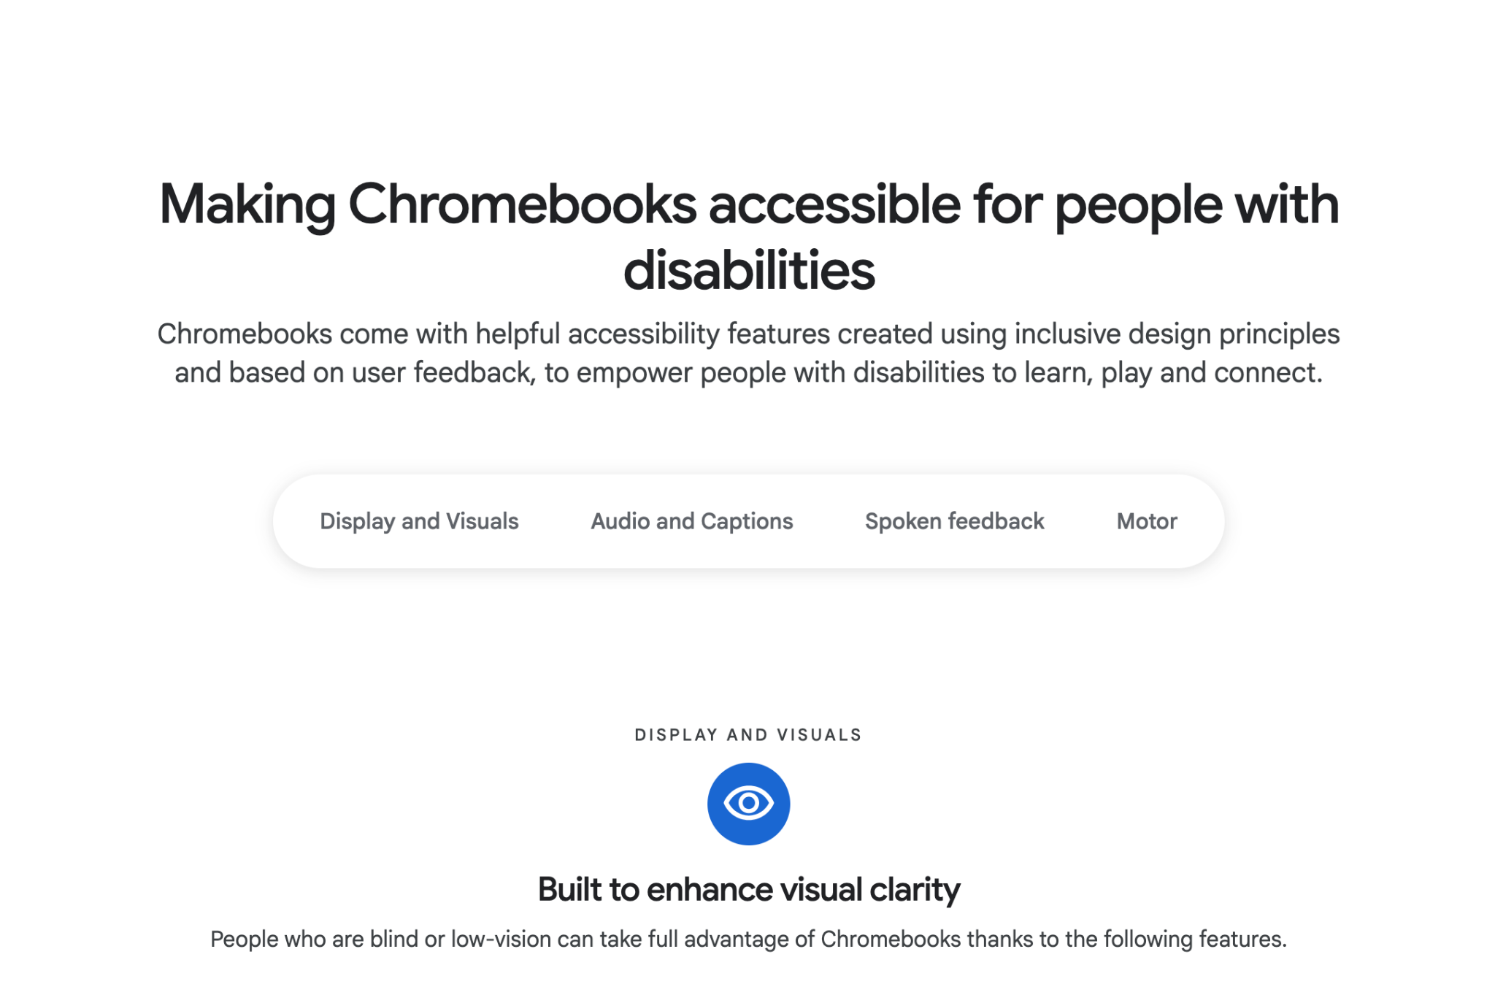
Explore Chromebook Accessibility Features
Go to google.com/chrome book/accessibility/
Scroll through the list of features to learn what options are available.
Explore tutorials, such as How to turn on Chromebook accessibility features.

Slide 37
Magnify Your Screen

Slide 38
Read Aloud

Slide 39
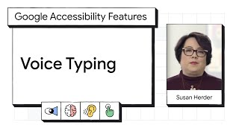
Voice to Text

Slide 40
Change Your Chromebook’s Language

Slide 41
Typing Practice
Free Online Resources Available to Practice Typing:
GCFGlobal Typing
BBC Dance Mat Typing

Slide 42
Chromebooks vs Windows Laptops

Slide 43
Chromebooks
Windows Laptops
Snappy performance on web-based tasks and boots quickly, but may struggle with demanding apps or heavy multitasking.
High-end Windows laptops excel at demanding tasks, while budget models perform similarly to or slightly below Chromebooks.
Performance
Web-based and Android apps cover most needs, but may fall short for users needing specialized desktop software.
Supports a wide range of desktop applications, including professional software for graphic design, video editing, and data analysis.
Apps
Prioritizes security with automatic updates, sandboxing, and verified boot, making Chromebooks highly resistant to malware and viruses.
Improved security features like Windows Defender than in the past, but its popularity and complexity make it a frequent target for malware and viruses.
Security
Chromebooks are affordable, good for basic and intermediate tasks, and rely on cloud storage like Google Drive due to limited local storage.
Available from budget models under $300 to high-end devices, offering more flexibility and power at higher prices.
Value

Slide 44
BREAK

Slide 45
What is a Browser?

Slide 46
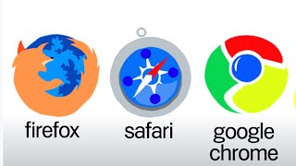
Browsers

Slide 47
Email

Slide 48
Email
On your browser
Open your email
Type www.gmail.com
Sign in

Slide 49
Email Etiquette Tips
Use a professional greeting and closing.
Follow a correct email format.
Subject line: be clear and concise
Email greeting
Email body: the message you want to communicate
Closing/Signature
Avoid emotional responses.
Proofread your email and review the tone of your writing.
Add the recipient’s address last.

Slide 50
Send me an email
[replace with instructor email]

Slide 51
Pre-Survey
Open up the Google Chrome browser.
In the web address, enter in the URL and complete the pre-survey
https://tinyurl.com/DSH-Pre-Survey

Slide 52
Wrap-Up

Slide 53
Wrap-Up
Questions from class
Come with an email address for someone so next week we can send them an email
Turn in Devices

Slide 54
Video Resources

Slide 55
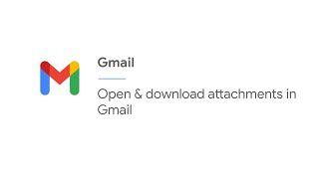
Gmail - Attachments

Slide 56
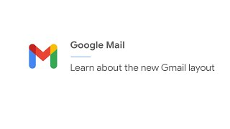
Gmail - Updated Layout

Slide 57
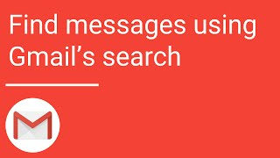
Gmail - Text Search

Slide 58
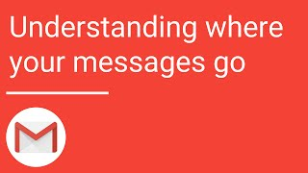
Gmail - Inbox Management

Slide 59
Gmail - Text Search

Slide 60
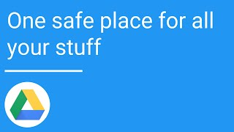
Google Drive - Overview

Slide 61
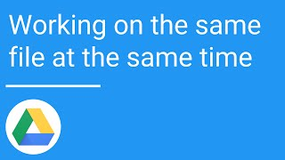
Google Drive - File Collaboration

Slide 62
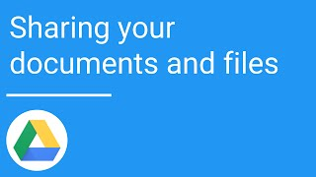
Google Drive - File Sharing

Slide 63
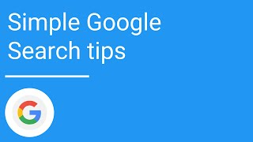
Internet Browser - Search Tips

Slide 64
Internet Browser - Search Refinement Tips

Slide 65
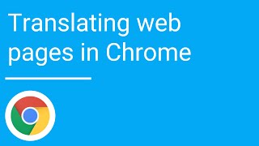
Internet Browser - Translating Web Pages

