Slide 1
Digital Skills Hub
Foundations - Lesson 1
Notes:
5 min.
Welcome by facilitator(s)
Introduce yourself and provide an overview of the session.

Slide 2
Lesson 1 Agenda
Welcome and Introductions
Purpose of this Course
Out of the Box
Course Requirements
Technology Use
Pre-Survey
Email

Slide 3
Welcome and Introductions
Notes:
10 min.
Introduction by participants
Have each participant do an introduction and a fun fact (e.g., one thing they want to learn from the course, an app they use often, etc.)

Slide 4
Welcome!
Introduce Yourself
Name
Share one fact about yourself
Why this class? What do you want learn?

Slide 5
Today’s Goals
Goals
To become familiar with one another and the course.
To get to know your device and how it operates.
To create a Google Account.
To begin the evaluation process and take the pre-survey

Slide 6
Purpose of this Course
Notes:
5 min.
Purpose of this Foundations course
Provide an overview of the course and the program.

Slide 7
Welcome to the Digital Skills Hub!
This program is here to help you learn the digital skills you need to feel confident using technology in your daily life.
The Digital Skills Hub is a community effort, supported by the City of Columbus and Franklin County, to make sure everyone has the opportunity to keep up with today’s digital world.
We’re excited to have you here and help you build the skills that will make technology easier to use and more helpful for you!

Slide 8
Importance of Digital Skills in Today's World
Digital skills help you get ready for jobs by giving you the tools to succeed in a world where technology is everywhere.
These skills also make it easier to use important online services, like banking, healthcare, education, and staying connected with friends and family.
By learning these skills, you’ll be able to fully participate in today’s society and feel more included, connected, and empowered in a world that’s always changing.

Slide 9
Alternative Activities
While the content in this course is best suited for beginners, additional activities for students with intermediate digital skills are included.
The arrow icon indicates an activity that can be completed independently by those with advanced digital skills.
Links to these activities can be found in the daily email or by typing the URL into your browser.
Example:
Alternate Activity
Explore accessibility features on iPad.

Slide 10
Accessing Course Resources
Go to www.gmail.com.
Log in with your username and password.
Click on email from instructor with subject line “DSH Day ”
Click on the activity title in blue.
OR
Enter in the URL from the presentation slides into your browser

Slide 11
Course Requirements
Notes:
10 min.
Course requirements
- Provide the dates of sessions /schedule
- Attendance
- Pre/Post Survey requirements- Final showcase
- Norms - Through group discussion, generate norms for the class (e.g., respect others, we are all learning, support your neighbor, etc.). Record on large Post-it paper or whiteboard. Will review each week.
***Edit this slide with your information

Slide 12
Requirements
Attendance: Must attend all sessions
Survey: Take the Pre- and Post-Survey
Final Showcase: Show one thing you learned in the course
DATE | TIME | HOURS
(e.g. Tues Nov. 12) | xx-xx pm | x hours
— | xx-xx pm | x hours
— | xx-xx pm | x hours
— | xx-xx pm | x hours

Slide 13
Discussion - Norms
What expectations do we want for our class?

Slide 14
Technology Use
What devices do you have at home and what applications/websites do you use most often?
Notes:
10 min.
Technology use
Ask the questions - what devices do you have at home and what applications/websites do you use most often? This will give you a better understanding of their tech knowledge and use.
You can do this in a couple of ways. Have individuals write their responses on post-it notes and place in front of room or have a general discussion about it.

Slide 15
Out-of-the-Box
Notes:
45 min.
Out of the Box
Since it takes a bit of time to get the devices set up, we are going to jump right in. The purpose of this activity is to get them familiar with the devices. Have them take the device out of the box and do the following:
- Plug in the device
- Turn on the device
- Follow the set-up instructions for the device, including choosing the language, connecting to the Internet and creating Apple Accounts.
- Attach any accessories (e.g., keyboard, mouse, etc.)
iPad

Slide 16
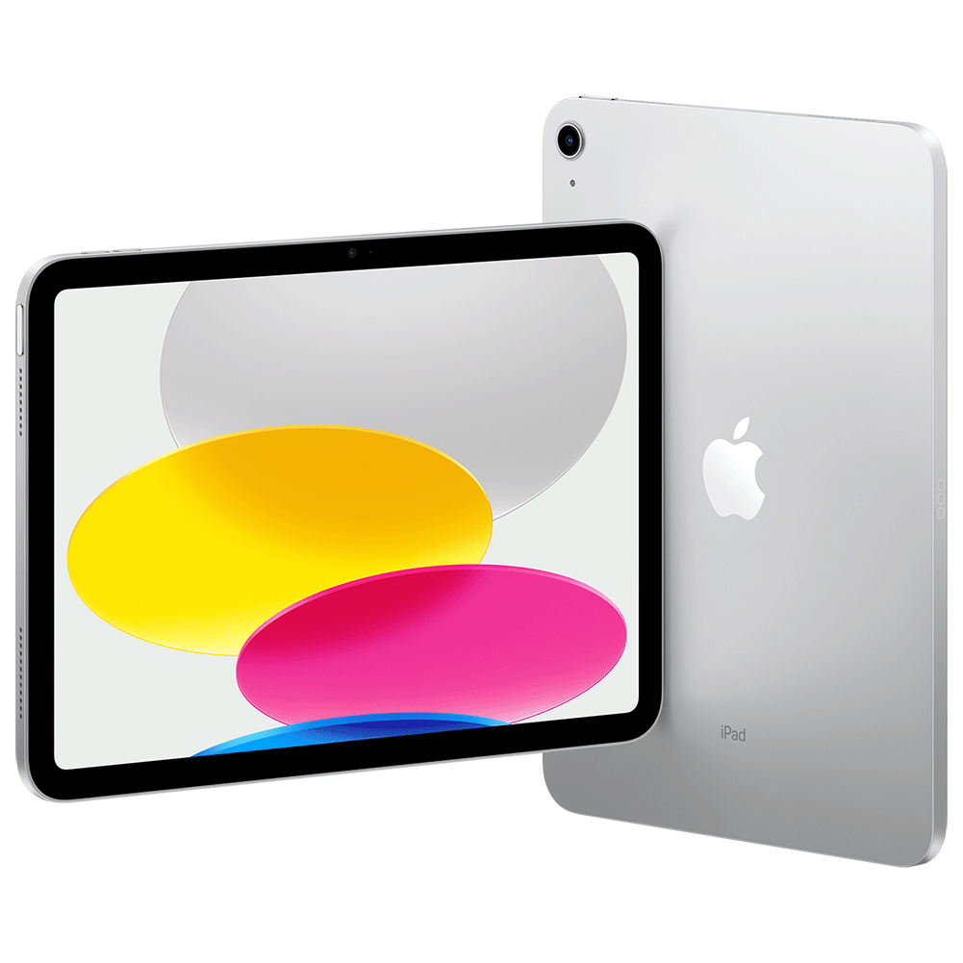
iPad 10.9”

Slide 17
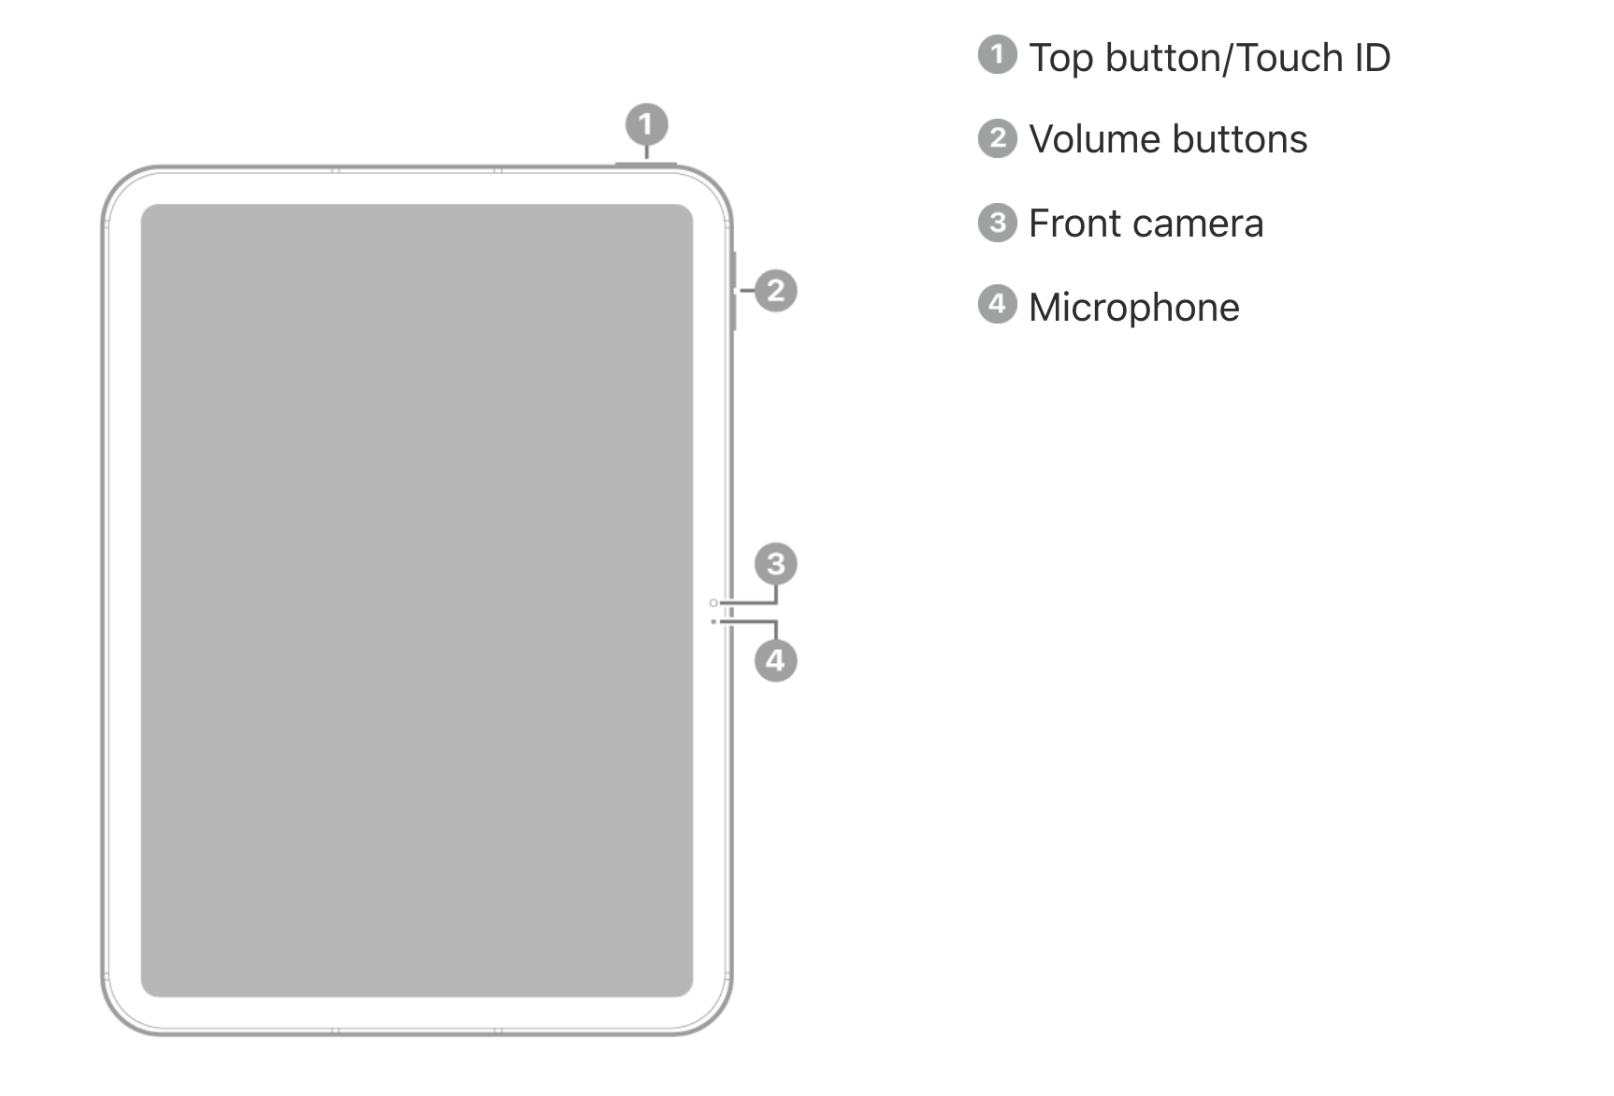
Front view
Know Your Device

Slide 18
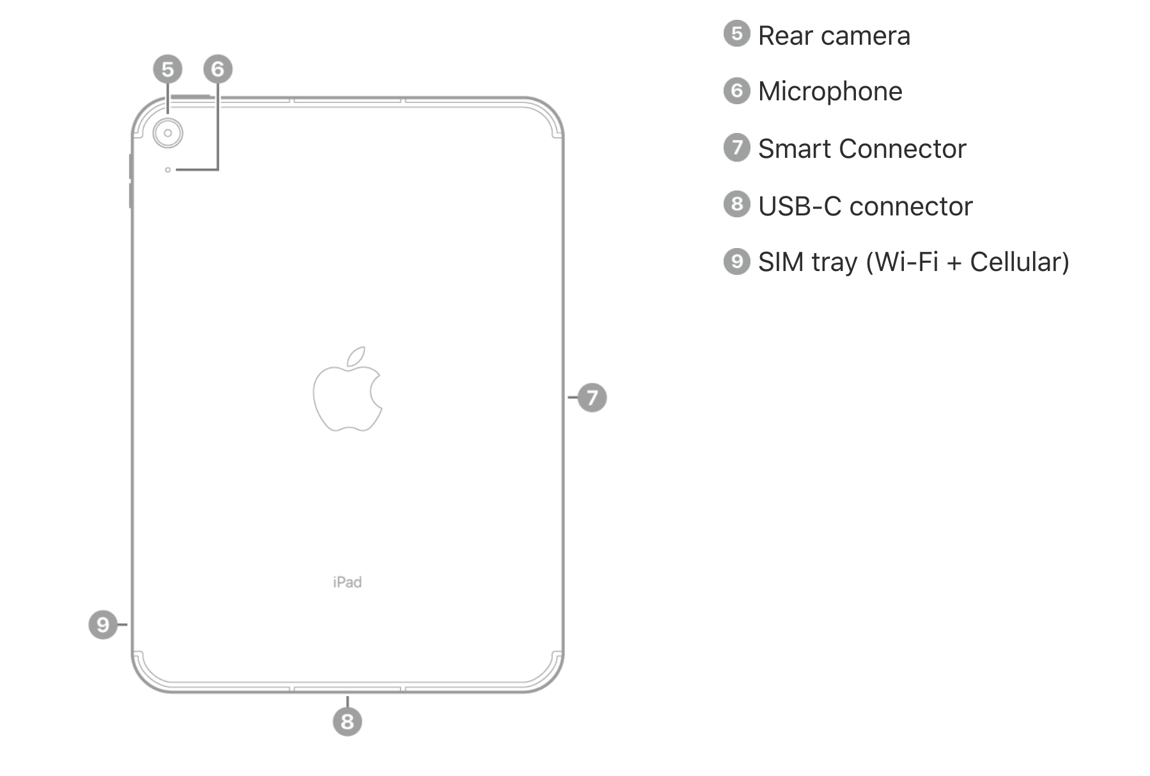
Rear view
Know Your Device

Slide 19
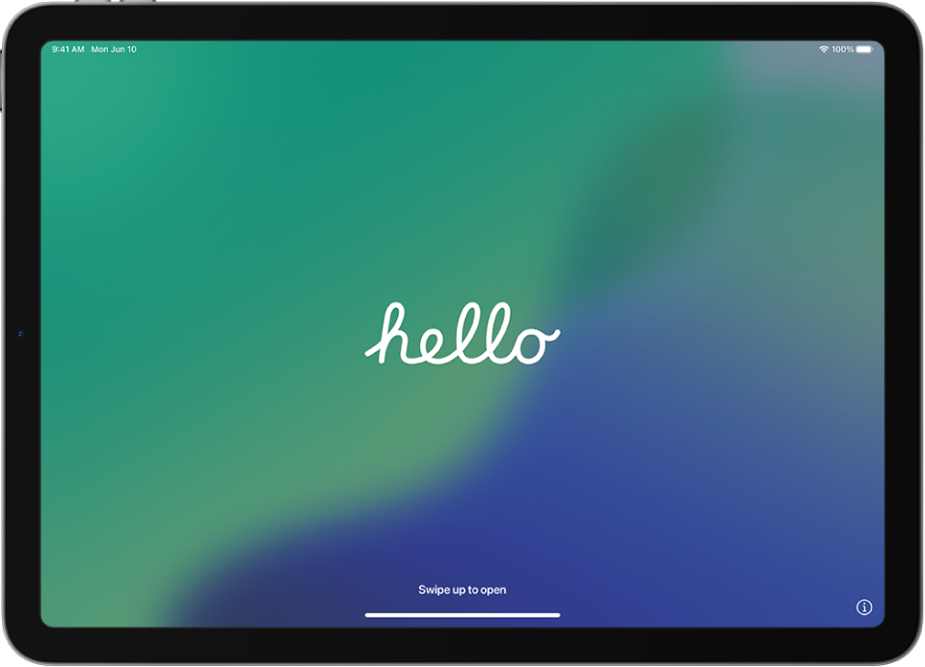
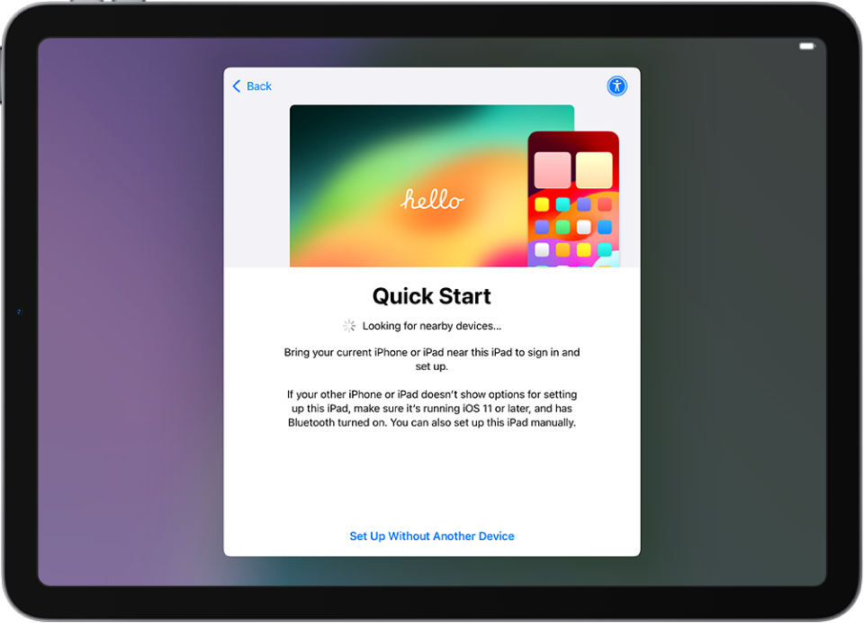
Getting started with iPad
To set up your iPad, you'll need:
Access to internet (WiFi)
Your Apple Account and password; if you don’t have an Apple Account, you can create one during setup

Slide 20
Turn on your iPad
Press and hold the top button until the Apple logo appears. If iPad doesn’t turn on, you might need to charge the battery

Slide 21
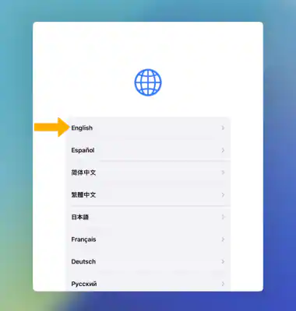
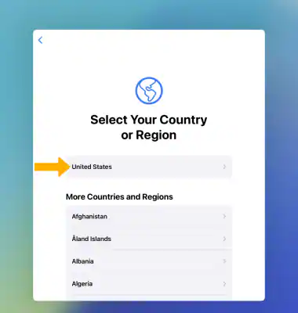
Select your language
Select your language
Select your country or region

Slide 22
Set up your iPad
Review the Quick Start prompt. Select Set Up Without Another Device to set up your iPad manually

Slide 23
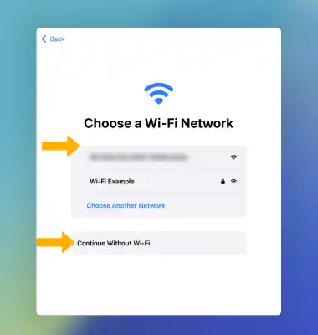
Connect to WiFi
View available networks and connect to WiFi
To join an available network: Tap the name of the network. If asked, enter the password

Slide 24
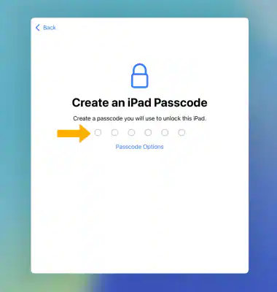
Create a Passcode (optional)
You can create a Passcode to unlock your iPad if you want. A Passcode is a numerical code that you can use as an alternative to TouchID
Enter a Passcode of 6 digits
Then re-enter your passcode to confirm

Slide 25
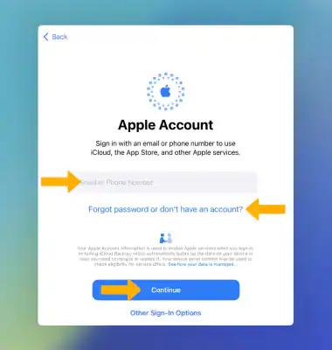
Sign in to your Apple Account
Enter your Apple ID then select Continue
Enter your password, then select Continue again
If you don't have one, select Forgot password or don't have an Apple ID? and follow the prompts

Slide 26
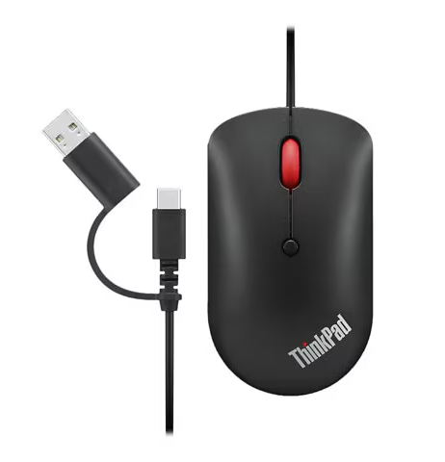
Attach Accessories
Connect your mouse to your iPad. Use the USB Type-C port on the side to connect the mouse cable

Slide 27
iPad Interface
Notes:
15 min.
iPad interface and interaction
Provide an overview of the basic gestures you can use on iPad.
Present the mouse as an accessory and its interface.

Slide 28
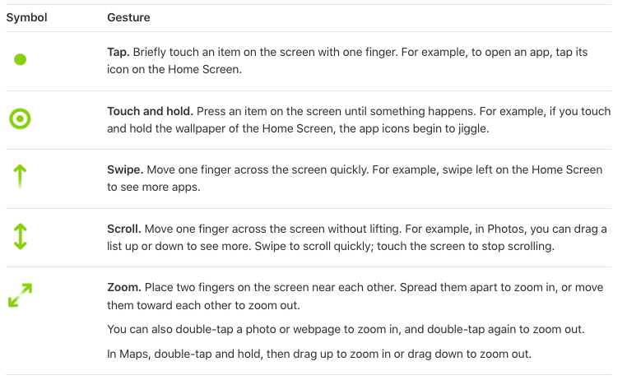
iPad basic gestures
QR code
Alternate Activity
Explore accessibility features on iPad.
tinyurl.com/DSHaccess

Slide 29
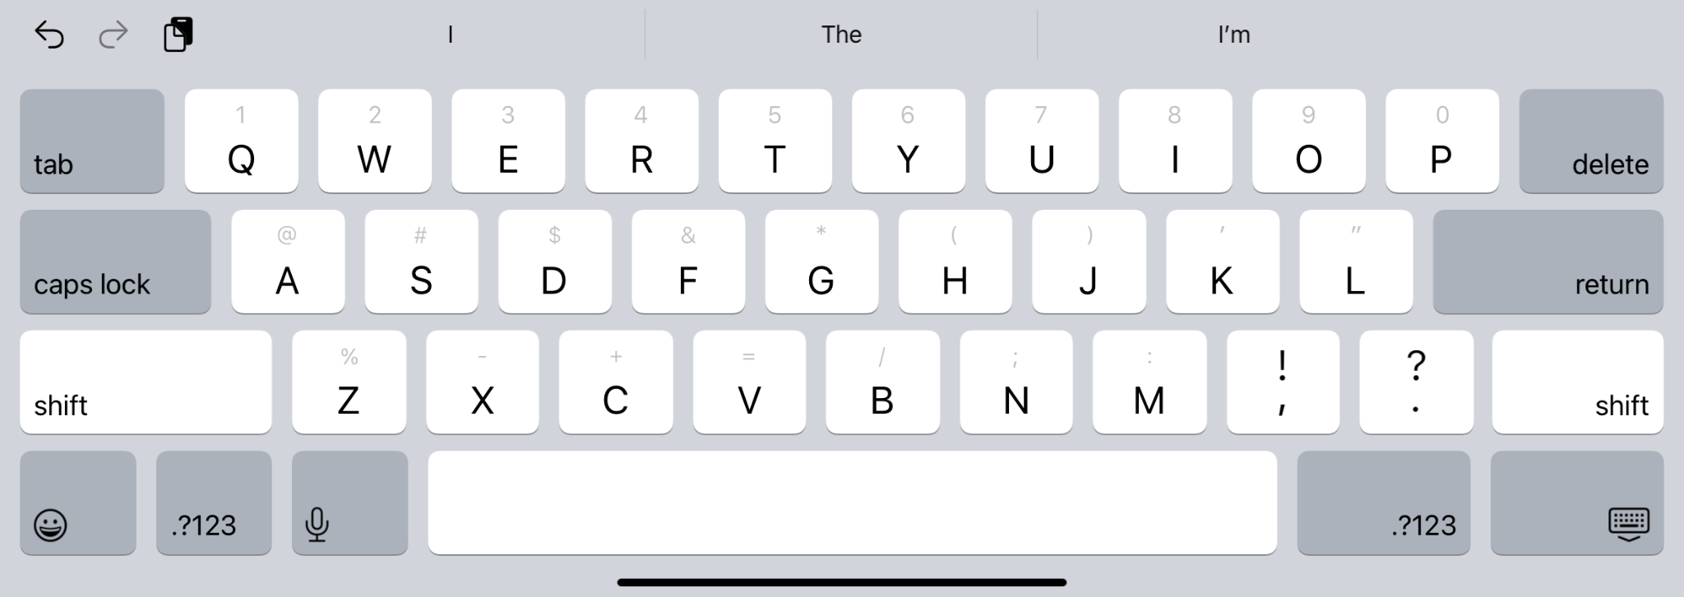
Keyboard Overview
Letter Keys
Backspace
Key
Shift Key
Spacebar
Numbers & Special Characters

Slide 30
Keyboard Overview
Predictive Text
Hide
Keyboard
Voice Dictation
Emoji Keyboard

Slide 31
Change Keyboard Language
Go to Settings > General > Keyboard.
Tap Keyboards, then do any of the following:
Add a keyboard: Tap Add New Keyboard, then choose a keyboard from the list. Repeat to add more keyboards.
Source: https://support.apple.com/en-gb/guide/ipad/ipad1aa5a19a/ipados
Remove a keyboard: Tap Edit, tap next to the keyboard you want to remove, tap Delete, then tap Done.

Slide 32
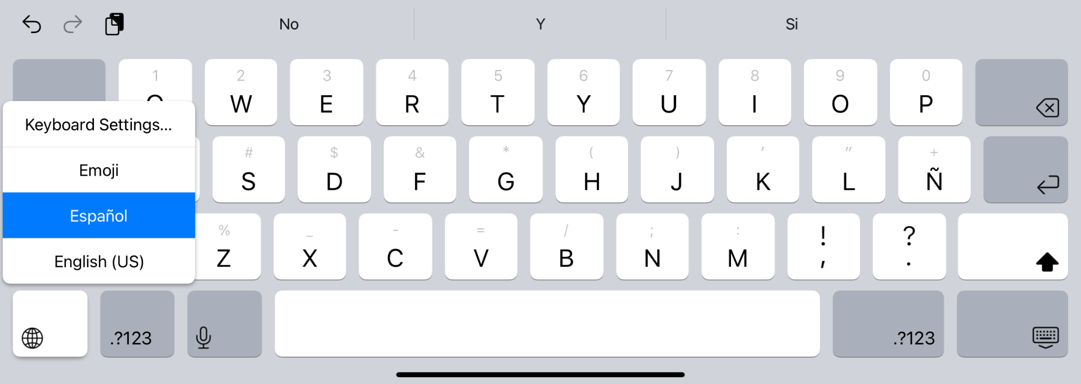
Change Keyboard Language
Press and hold globe or emoji icon to switch keyboards.

Slide 33
Typing Practice
Free Online Resources Available to Practice Typing:
GCFGlobal Typing
BBC Dance Mat Typing
iPad Keyboard Overview:
Using the iPad Keyboard

Slide 34
Using a Computer Mouse

Slide 35
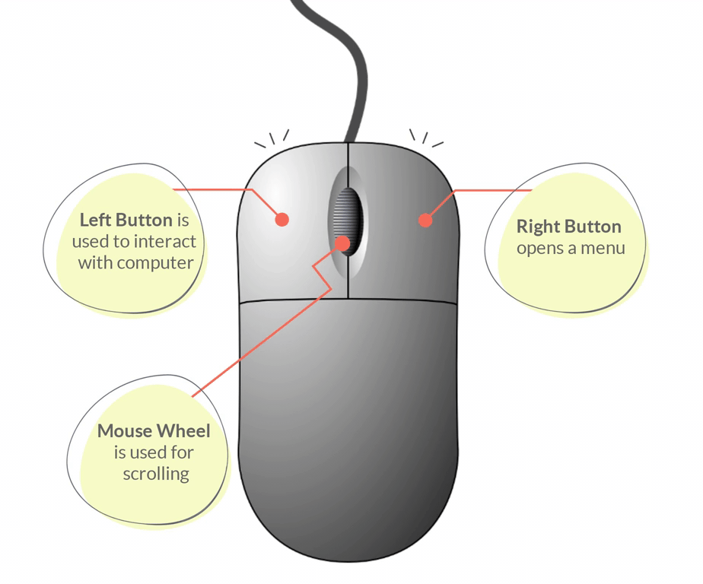
Using a Computer Mouse
Other mouse resources:
Mouse Tutorial
Mouse Exercises

Slide 36
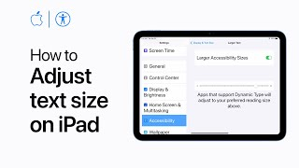
Adjusting Text Size

Slide 37
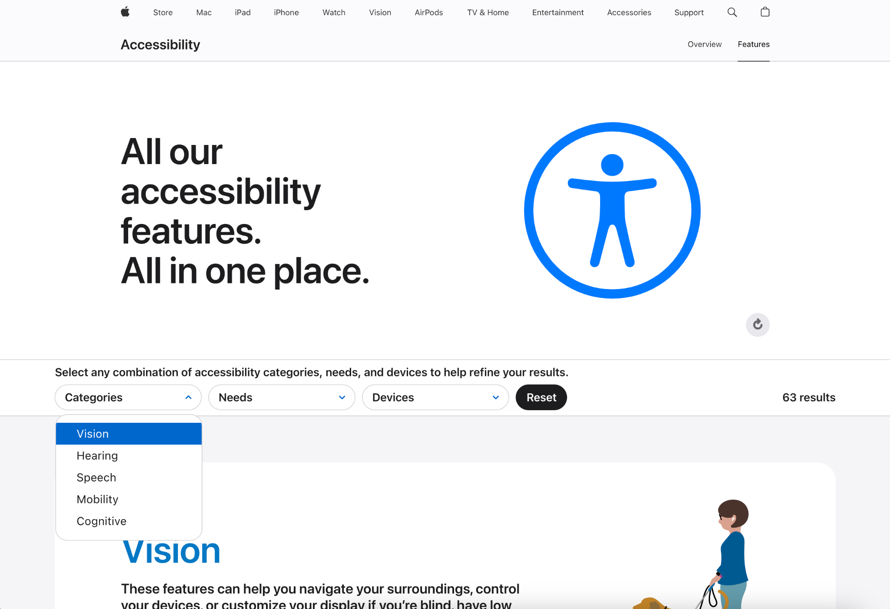
Explore iPad Accessibility Features
Go to apple.com/accessibility/features/
Scroll down and explore the features or specify your search by selecting categories, needs or devices.
Locate a feature you’d like to learn about and then select Read More.
Notes:
Lesson Guide: Other iPad accessibility feature resources: tinyurl.com/access-features-mobility

Slide 38
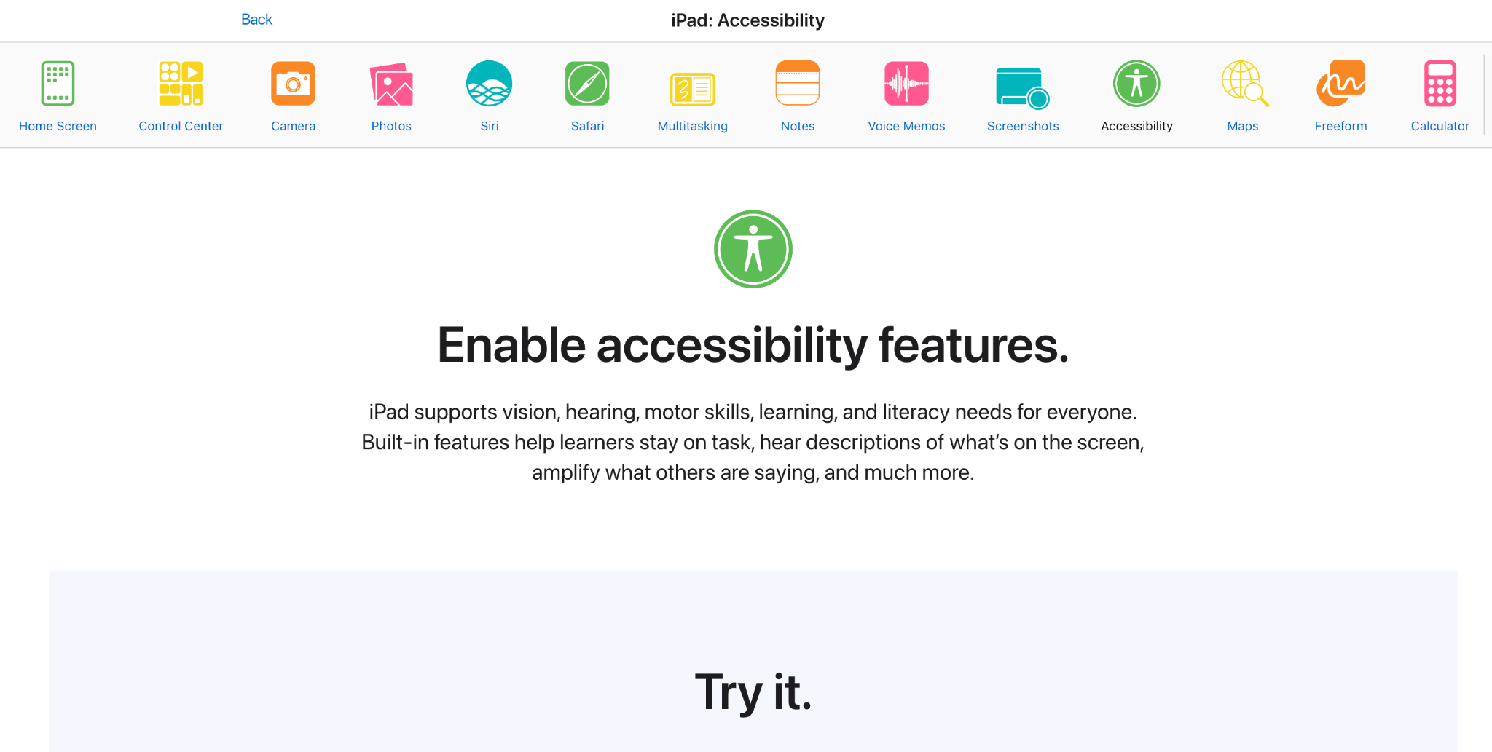
Spoken Content
Go to tinyurl.com/access-features
Select Accessibility
Scroll down to the Try it section for a tutorial on enabling read aloud features

Slide 39
iPads vs Windows Laptops
Notes:
5 min. (optional)
iPads vs Windows Laptops
If you have time, present high level differences between iPads and Laptops.

Slide 40
iPads
Windows Laptops
Smooth and efficient for most tasks, with excellent optimization for apps and multitasking in newer models.
High-end models handle demanding tasks effectively, while budget models vary in performance and can be less fluid compared to iPads.
Performance
Access to a wide range of apps via the App Store, including creative, productivity, and entertainment tools.
Supports traditional desktop applications, including professional-grade software for design, development, and business use.
Apps
Strong security with regular updates, app sandboxing, and a controlled app ecosystem. Highly resistant to malware and viruses.
Improved security with Windows Defender, but still more vulnerable to malware due to a more open system and its popularity.
Security
Offers a variety of models from budget-friendly (iPad) to premium (iPad Pro). Versatile but requires additional accessories for full productivity.
Wide price range from budget models to premium options. Provides a better value for those needing desktop-like functionality.
Value

Slide 41
BREAK
Notes:
5 min.
Break

Slide 42
What is a Browser?
Notes:
5 min.
Browser
Introduce the concept of the browser and the Internet through the quick introduction video.
- Show them how to open a Browser and explain the purpose of a Browser
- Show the video on What is a Browser?

Slide 43
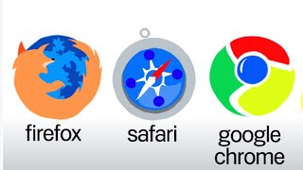
Browsers

Slide 44
Google Accounts
Notes:
15 min.
Google Account
Have the participants create a Google account. Walk them through the slide and how to do it.
- Go to www.google.com/account
- Click Create account and complete the appropriate information.
- Encourage them to create a username that is appropriate to communicate with others - doctor, teacher, etc. Have them write down their username and password on the Device Information Sheet so they can log in later.

Slide 45
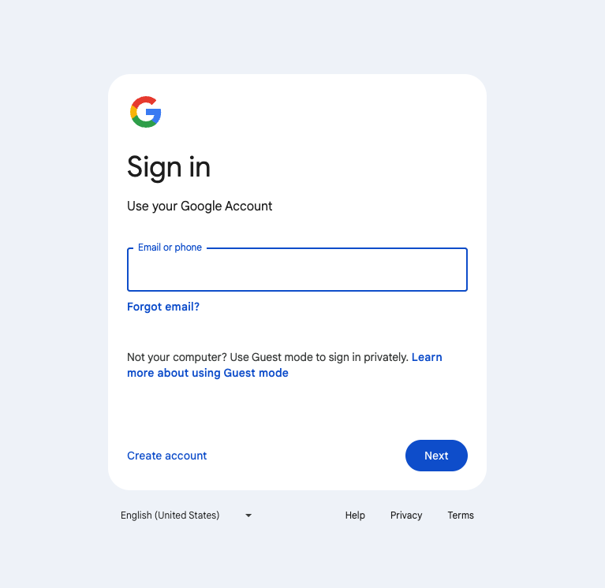
Sign in with your Google Account
Using your browser go to www.google.com/account
Sign in with your Google email (gmail) and password
If you don’t have a Google email , tap on “Create an Account.”
Follow the instructions

Slide 46
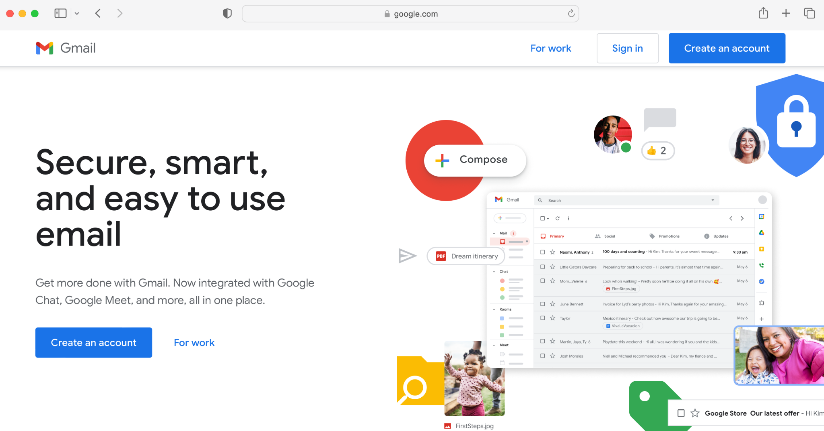
Creating a Google Account

Slide 47
Creating a Google Account
Choosing a Username
Used to communicate with others
Be appropriate
Make take a few tries to find a unique one
Choosing a Password
Something that has numbers, letters, and symbols
Nothing too easy to figure out like ABC123

Slide 48
Email
Notes:
5 min.
Email
- Provide your email address and have each participant send you an email. Before next week's session, send each participant an email welcoming them to the course.
- Prior to the start of this activity, poll and determine who has accounts. - If participants have an account, ensure they can log in and remember their password. If this can be accomplished, have them explore the other Google Mail Resources. (located in Content Resources - Google).

Slide 49
Email
On your browser
Open your email
Type www.gmail.com
Sign in

Slide 50
Email Etiquette Tips
Use a professional greeting and closing.
Follow a correct email format.
Subject line: be clear and concise
Email greeting
Email body: the message you want to communicate
Closing/Signature
Avoid emotional responses.
Proofread your email and review the tone of your writing.
Add the recipient’s address last.

Slide 51
Send me an email
[replace with instructor email]

Slide 52
Pre-Survey
Open up the Google Chrome browser.
In the web address, enter in the URL and complete the pre-survey
https://tinyurl.com/DSH-Pre-Survey

Slide 53
Wrap-Up
Notes:
5 min.
Wrap-up
- Close and wrap up for the session. Make any necessary announcements so they are prepared for the next session.
- Homework - have them come to the next class with an email address of someone so they can send them an email during the next class.
- Collect devices. If desired, use masking tape and have participants label their device.

Slide 54
Wrap-Up
Questions from class
Come with an email address for someone so next week we can send them an email
Turn in Devices

