Slide 1
Digital Skills Hub
Foundations - Lesson 4

Slide 2
Lesson 4 Agenda
Welcome
Review
Protecting Devices
Evaluating Online Information
Basic Email and Internet Privacy and Security
Final Showcase Planning

Slide 3
Welcome

Slide 4
Today’s Goals
Goals
To protect their device from security threats.
To discern deep fakes, authoritative sources, and evaluating media.
To understand basic privacy and security issues with email and Internet.

Slide 5
Welcome!
Set up your device

Slide 6
Norms
INSERT NORMS HERE

Slide 7
Google Apps

Slide 8
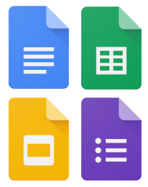
Review
Spend some time reviewing some of the work you did last time in Google Apps.

Slide 9
Protecting Devices

Slide 10
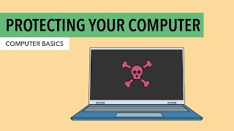
Protecting Your Computer

Slide 11
Using Public WiFi
WiFi Hotspots - access numerous places (coffee shops, library, and many others)
Ensure you are on a legitimate network. Don’t use common names like Free WiFi or Public WiFi or an individual’s name.
Turn on your firewall (show them how to do this)
Disable File and Printer Sharing to prevent others on the network from accessing your files (show them how)
Do not conduct important transactions in public (e.g., online banking, paying bills)

Slide 12
Tips
Always lock your device when in public
Set up Find My Device (show them how to do this)
Only download/install from known entities
Uninstall apps you don’t use (show them how to do this)
Keep your device and software up-to-date (show them how)
Use a passcode to log in

Slide 13
Tips to Create a Strong Password
Never use personal information such as your name, birthday, username, or email address. This type of information is often publicly available, which makes it easier for someone to guess your password.
Use a longer password. Your password should be at least six characters long, although for extra security it should be even longer.
Don't use the same password for each account. If someone discovers your password for one account, all your other accounts will be vulnerable.

Slide 14
Tips to Create a Strong Password
Try to include numbers, symbols, and both uppercase and lowercase letters.
Avoid using words that can be found in the dictionary. For example, swimming1 would be a weak password.
Random passwords are the strongest. If you're having trouble creating one, you can use a password generator instead. You can also use a password manager.

Slide 15
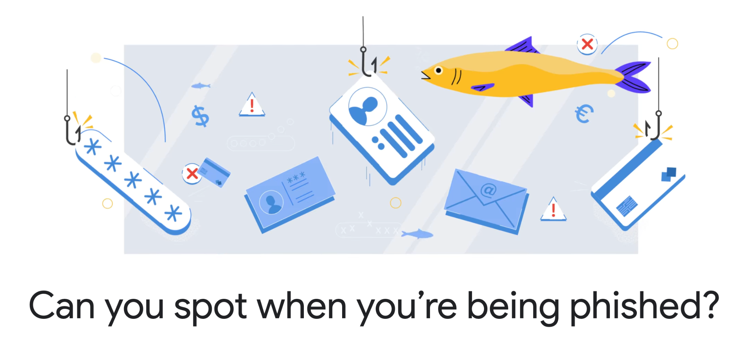
Google Phishing Quiz
phishingquiz.withgoogle.com
Notes:
https://phishingquiz.withgoogle.com/

Slide 16
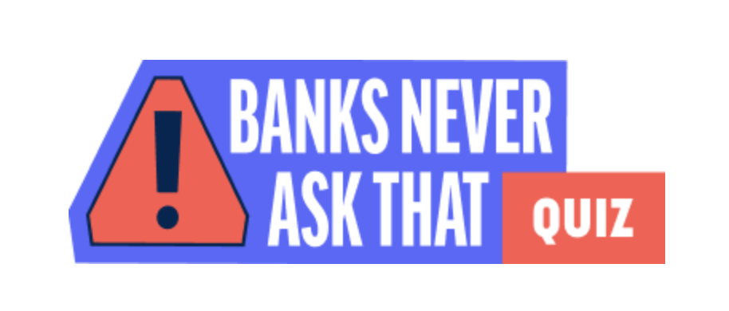
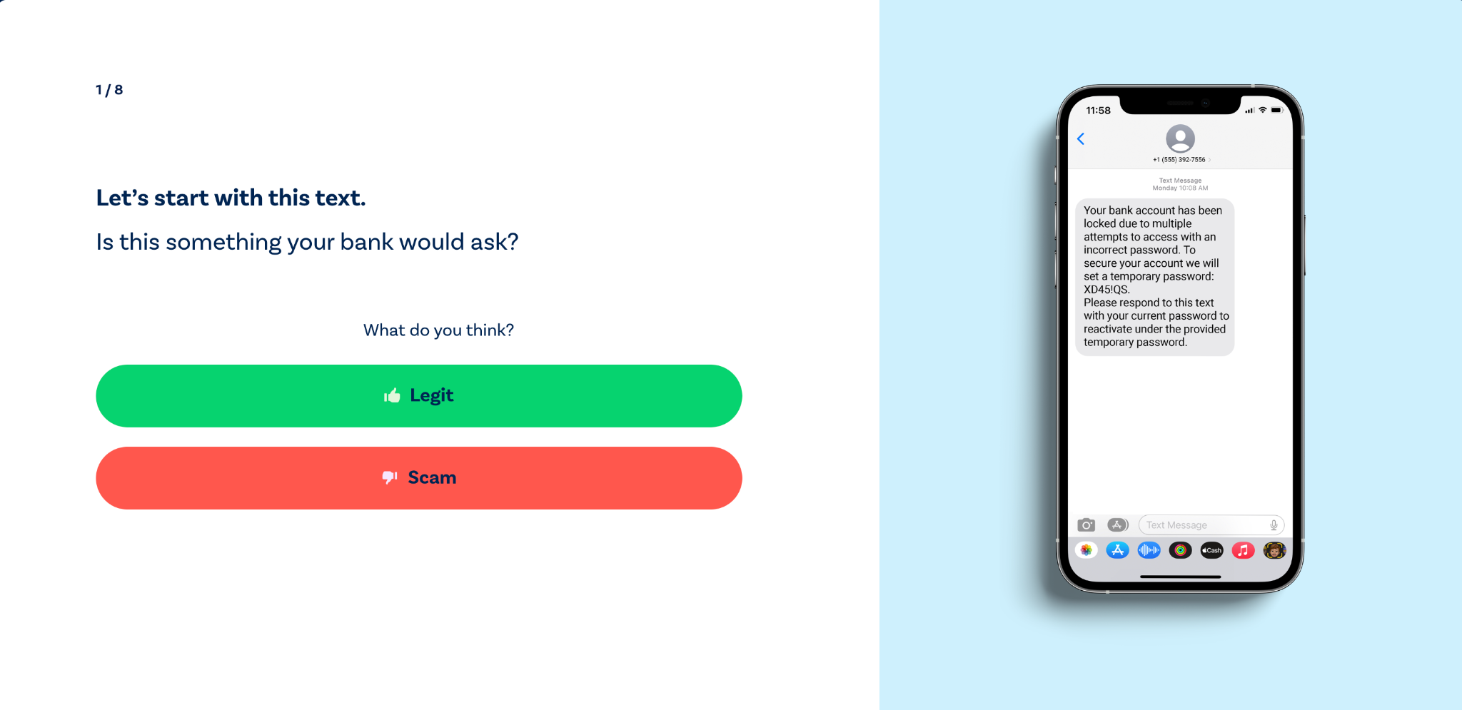
Banking Scam Quiz
banksneveraskthat.com/scam-quiz/
Notes:
https://www.banksneveraskthat.com/scam-quiz/

Slide 17
Is This Email Legitimate?
Do I have a relationship with this person or organization that sent the email?
Is this the email account I gave to this sender?
Is the sender using an email domain that someone from this organization would be using?
Is the email free from any broken links and/or bad grammar?
Is the email neutral in tone and does not try to get me to do something right away?

Slide 18
BREAK

Slide 19
Judging Online Information

Slide 20
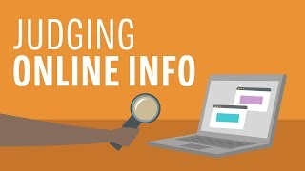
Judging Online Information

Slide 21
Evaluating Websites
Spend some time finding a website
Complete the Evaluating Websites handout
Alternate Activity
Learn more about how to analyze the information you’re consuming online:
tinyurl.com/evaluate-info

Slide 22
Discussion
Was your site reliable? Why or why not?
What questions do you have?

Slide 23
Basic Email & Internet Privacy and Security

Slide 24
What to Protect
Create strong passwords
Browser security
Spam and Phishing
Checking validity (e.g., don't give out your banking information because they are going to give you $50m)

Slide 25
Explore
Spend some time exploring Internet Safety and Internet Safety Tips
https://tinyurl.com/internet-safety-101
https://tinyurl.com/int-safety-tips-101

Slide 26
Final Showcase Planning

Slide 27
Think About
What are you going to share?
How are you going to share it? (e.g., Google Slides, Internet Resources, etc.)
What will you show and the steps?
What do you still need to learn in order to share?

Slide 28
Wrap-up

Slide 29
Wrap-Up
Questions from class
Turn in Devices

