Slide 1
Digital Skills Hub
Foundations - Lesson 5

Slide 2
Lesson 5 Agenda
Welcome
Review
Internet Use
Chrome Extensions and Apps
Advanced Google Search
Final Showcase Planning

Slide 3
Welcome

Slide 4
Today’s Goals
Goals
To be able to use the Internet to access resources (e.g., telehealth, banking, bus routes, library).
To be able to add extensions and apps to browser and devices.

Slide 5
Welcome!
Set up your device

Slide 6
Norms
INSERT NORMS HERE

Slide 7
Internet Use

Slide 8
Using the Internet
What are uses of the Internet?
Keep in mind:
Bias
Privacy and Security
Good Digital Citizen
Reliability

Slide 9
Explore
tinyurl.com/int-resources

Slide 10
Apply for a Columbus Metropolitan Library Card Online
Go to www.columbuslibrary.org/apply-library-card/
Read agreement statements and select acknowledge
Enter contact information into the form and press submit
Receive digital library card number via email

Slide 11
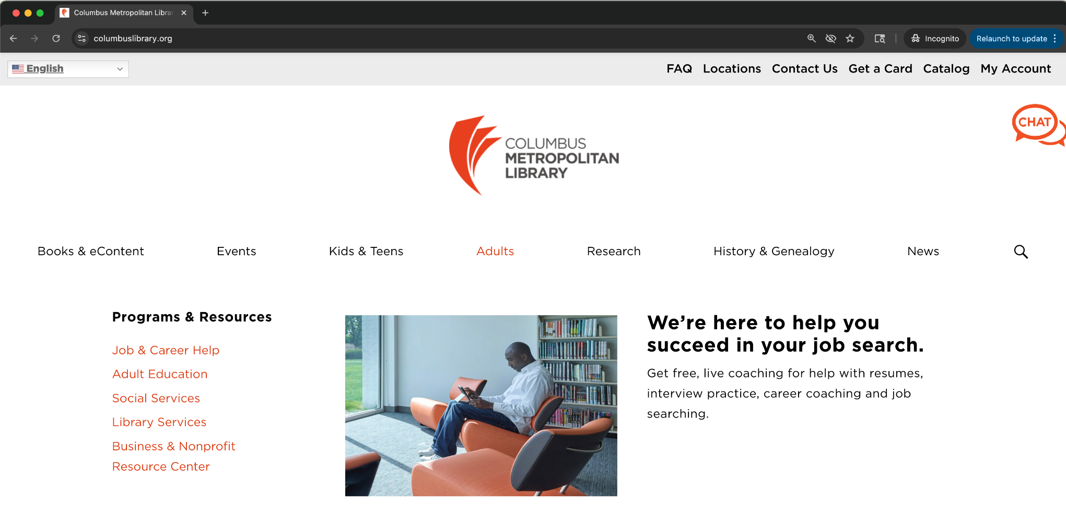
Access Free Workforce Development Resources With Your Library Card
Go to columbuslibrary.org
Hover your cursor over the Adults tab
Select Job & Career Help

Slide 12
Access Free Workforce Development Resources With Your Library Card
Browse free resources which include the following:
Got Resume Builder: Build your resume with step-by-step writing guides and context-sensitive writing tips (email address required).
Linkedin Learning: Choose from thousands of online courses to learn in-demand skills from real-world industry experts. Get started with your library card.
Job Now: JobNow offers immediate access to a Live Interview Coach and other online resources for resume writing and job searching. Services available Monday through Friday 2pm-11pm.
Notes:
Add source: https://www.columbuslibrary.org/job-help/

Slide 13
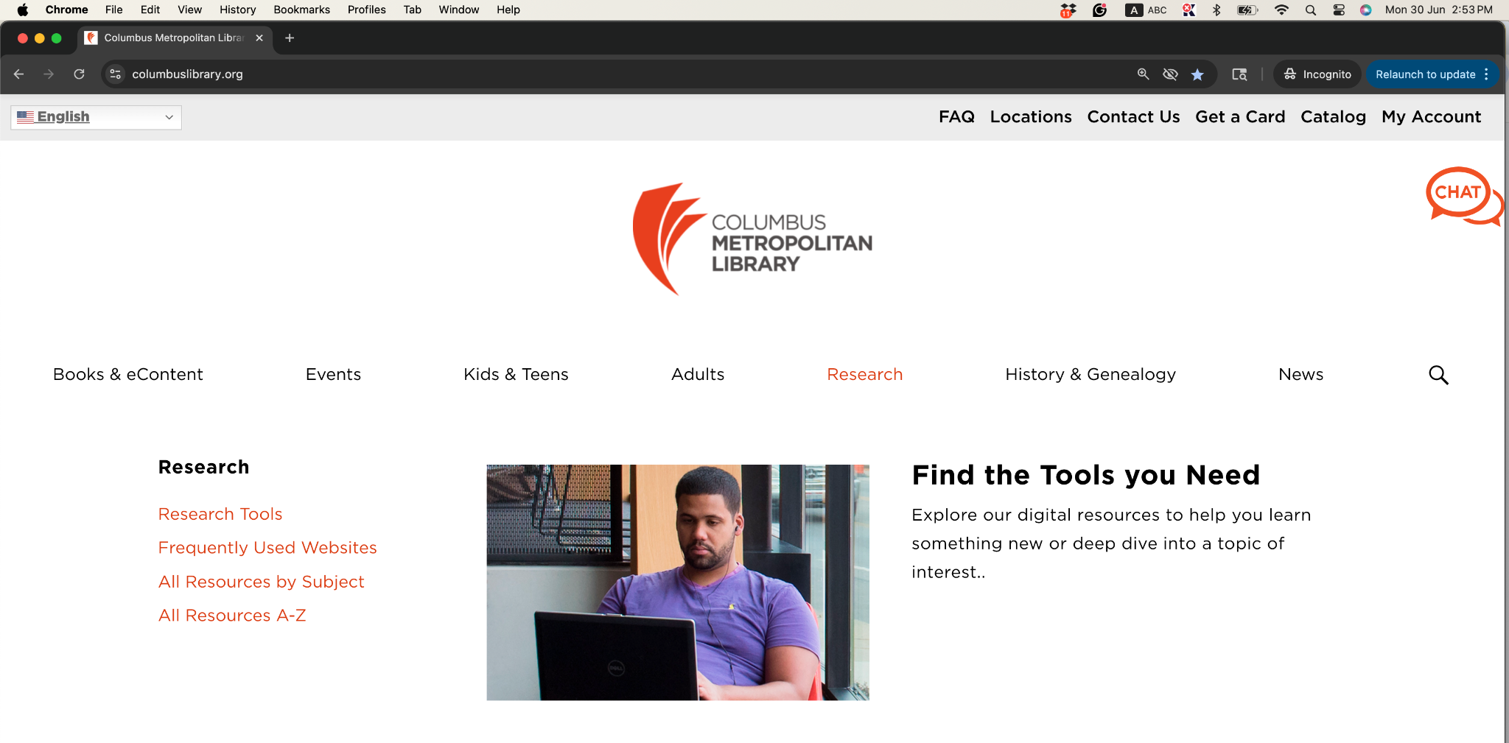
Access Free Resources Using Your Library Card
Go to columbuslibrary.org
Hover your cursor over the Research tab
Select All Resources by Subject

Slide 14
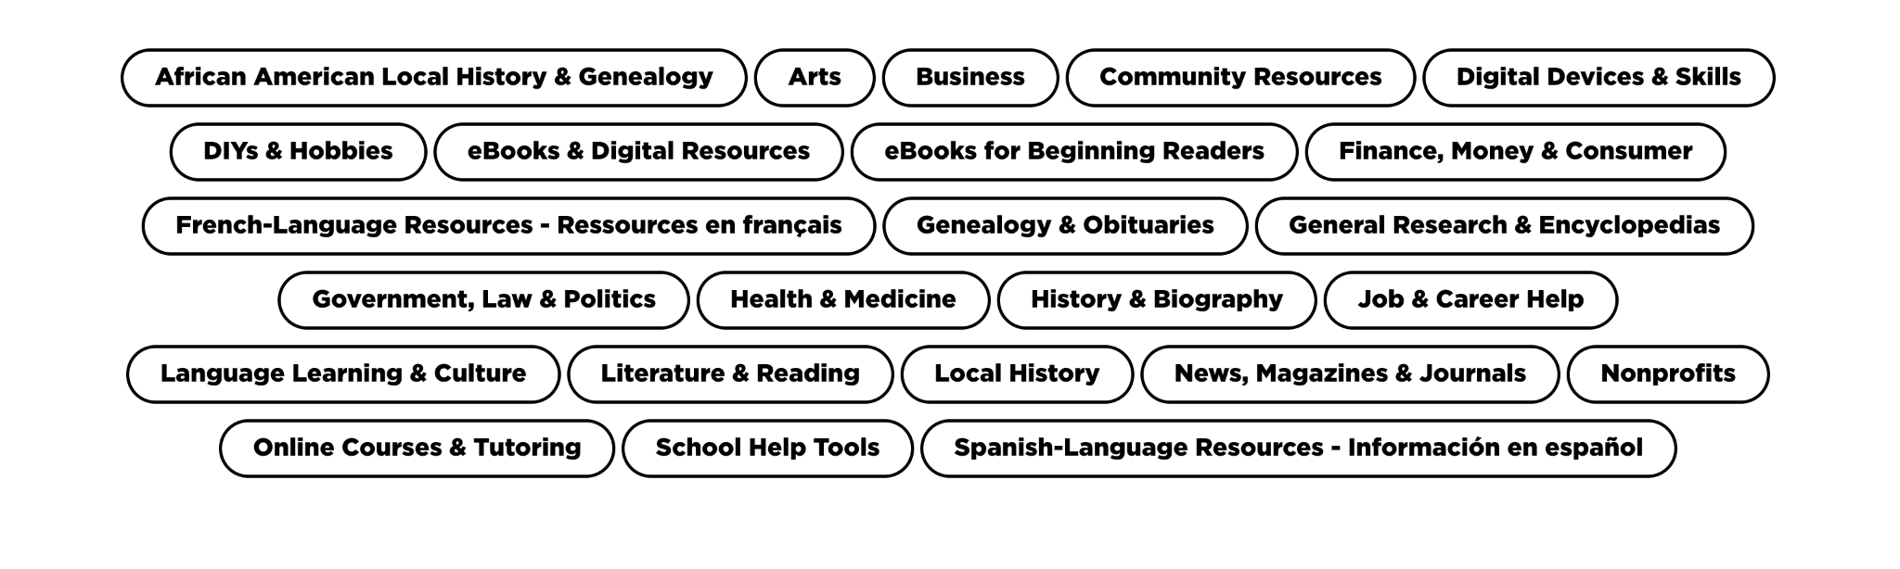
Access Free Resources Using Your Library Card
Browse resources which include a free streaming service, language learning tools, and digital skills tutorials.

Slide 15
BREAK

Slide 16
Chrome Extensions and Advanced Chrome

Slide 17
Extensions
Add features to the browser
Examples of Extensions
Password Manager
Ads Blocker
Grammarly

Slide 18
Advanced Chrome
Bookmarks
Customizing
Home page
Appearance
Language
More!

Slide 19
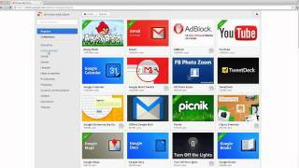
How to Discover
https://chrome.google.com/webstore
https://tinyurl.com/advance-chrome

Slide 20
More Google…

Slide 21
Google and…
Translate
Scholar
Images
Maps
Translate.google.com
Scholar.google.com
Images.google.com
maps.google.com
Alternate Activity
Translate images or text,
or create a community map:
tinyurl.com/more-googleapps

Slide 22
Use Google Translate to Translate a Website
Go to translate.google.com
Select Websites
In the search bar, paste or type the website address you wish to translate, and then press the blue arrow.
Your website will open with the translate bar on top. Select the language you want the website to be translated into.

Slide 23
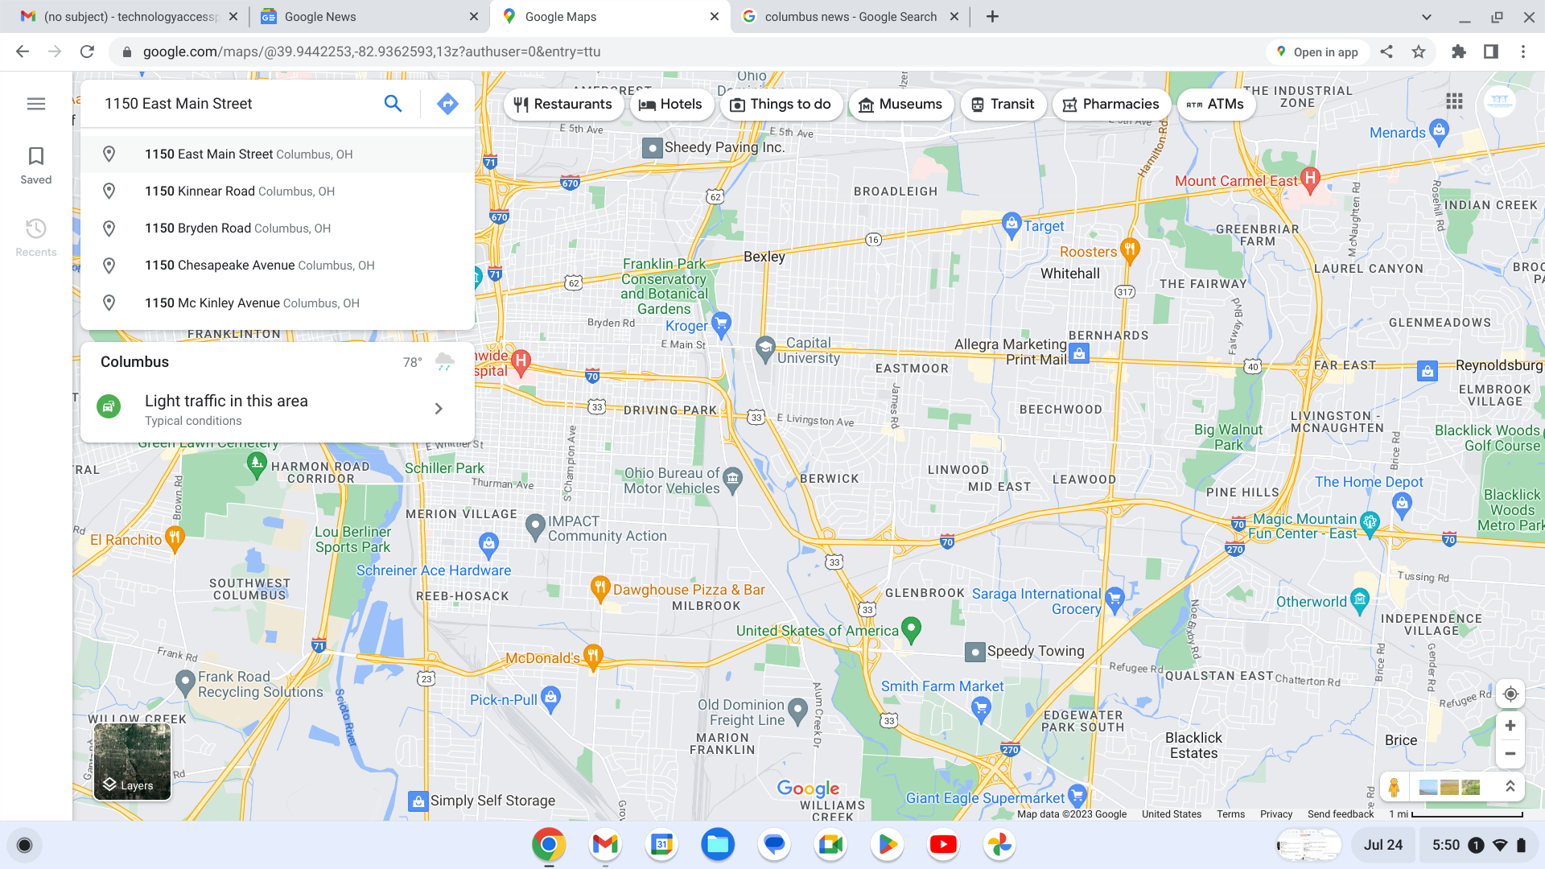
Plan a Trip on Google Maps
Maps is a navigation tool you can use to access detailed maps, satellite images, street view, and detailed navigation.

Slide 24
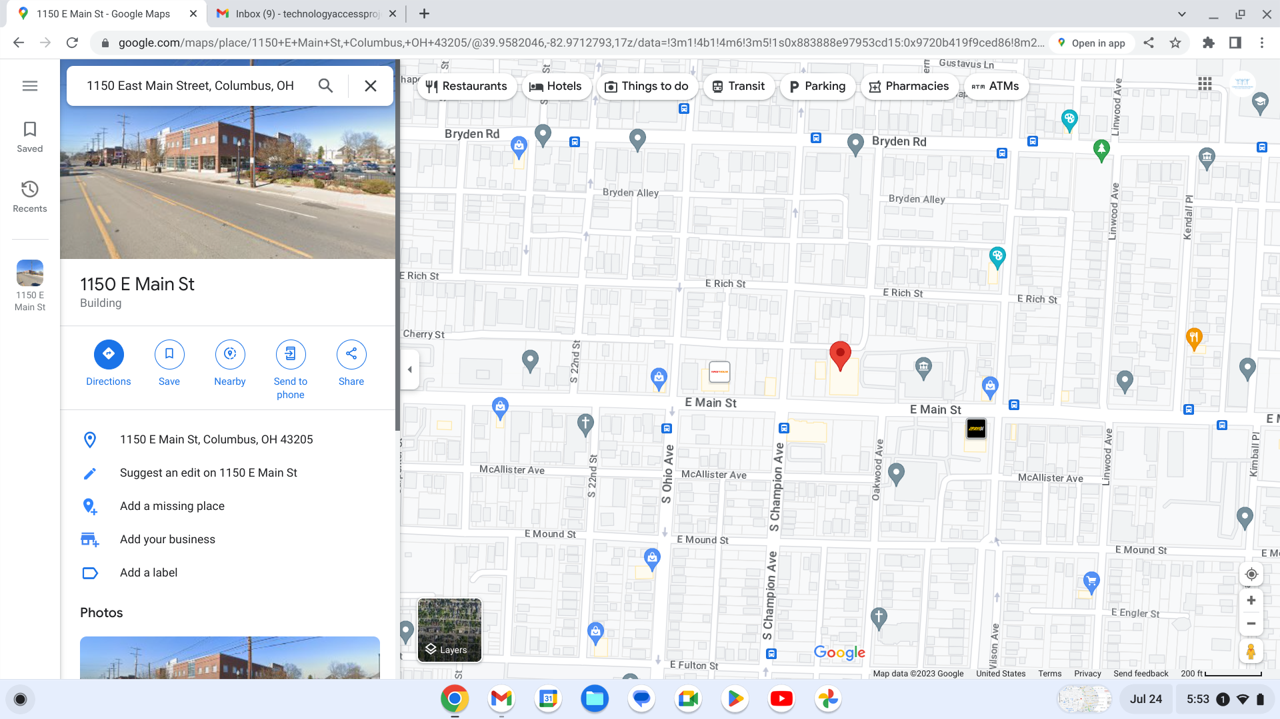
Google Maps Icons
To get directions from one location to the one entered, you click on directions.
Red Balloon–
The exact location of your destination.
Shopping Bag–
The exact location of a store.
Zoom
In/Out
Fork and Knife –
The exact location of a restaurant.

Slide 25
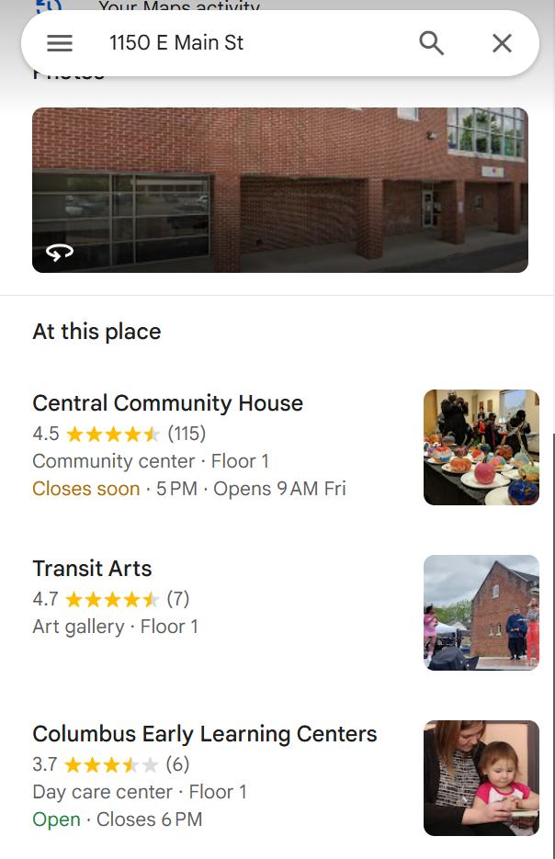
At This Place
By clicking on the picture of the building, you access a street view of the neighborhood, roam around, look at places near by, see what the area looks like, scope out parking, etc.
Beneath “At this place,” you can see places that are associated with the address that you typed in. By clicking on one of the places listed, you can see a more detailed overview of the organization or building (their phone number, website, hours of operation, and more).

Slide 26
Getting from Point A to Point B
Change Your Form of Transportation
When you click on the different options (car, public transportation, walking, or bicycling) the routes will change.
Starting and Ending Location
If you don’t know the exact address, try typing in the name of your destination (e.g. COSI), an intersection (e.g. W. Rich Street and Washington Blvd), or a nearby landmark (e.g. Topiary Park)
Change Your Departure/Arrival Time
This feature allows you to select your departure time or arrival time, which will provide a better estimate of how long your trip will take. You can select “Depart at” to enter the time you would like to leave, or “Arrive by” to enter the time you would like to arrive.
Route Options
Choose the route you prefer.

Slide 27
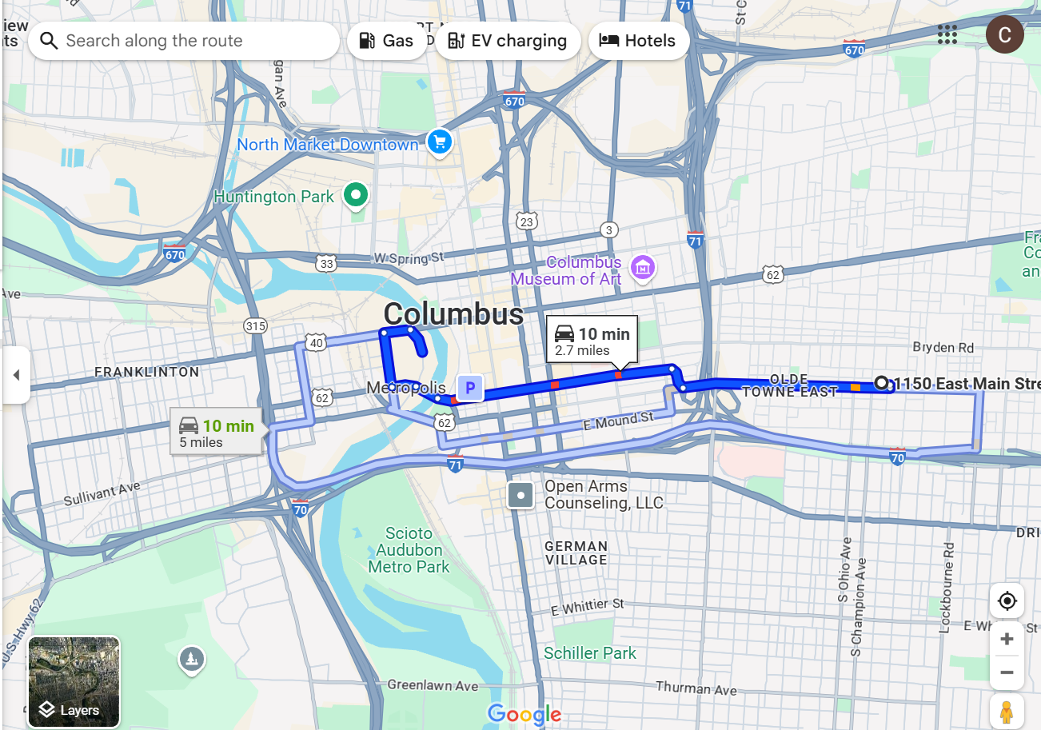
Understanding the Map
The dark blue line indicates that traffic is moving at a steady pace.
The red lines within your route shows heavy traffic.
Yellow lines within your route indicate moderate traffic.
The light blue lines are for alternate routes.

Slide 28
Practice Test!
Move your cursor to the X icon to clear the current information and start a new search.
Use Google Maps to answer the following question:
How long will it take to get from Columbus, Ohio to Seattle, Washington by bicycle?
Answer: 223 hours!

Slide 29
Final Showcase Planning

Slide 30
Think About
What are you going to share?
How are you going to share it? (e.g., Google Slides, Internet Resources, etc.)
What will you show and the steps?
What do you still need to learn in order to share?

Slide 31
Wrap-up

Slide 32
Wrap-up
Questions from class
Turn in Devices

