Slide 1
Digital Skills Hub
Foundations - Lesson 6

Slide 2
Lesson 6 Agenda
Welcome
Review
Social Media Overview
Introduction to AI
Final Exhibition Presentations
Post-Survey
Favorite Things

Slide 3
Welcome

Slide 4
Today’s Goals
Goals
Learn about popular social media apps and sites.
Be able to use a social media application.
Possess a high-level knowledge of AI and its possible implications.
Complete the post-assessment.
Present final showcase.

Slide 5
Welcome!
Set up your device

Slide 6
Norms
INSERT NORMS HERE

Slide 7
Social Media

Slide 8
What is Social Media?
Exchange of ideas and information.
Text, video, audio, images
Virtual communities

Slide 9
Various Apps
Instagram
WhatsApp
Facebook
Pinterest
Zoom
X (formerly Twitter)
YouTube
And many others…..

Slide 10
Reminder: Think Before You Share

Slide 11
Your Digital Footprint
Active digital footprints are those that are left behind from the intentional choices you make:
Social media posts
Photos and videos
Online comments
Location data
Phone calls
Online purchases
Texts
Emails
Passive digital footprints are those that are left behind without you intending to or even knowing about:
IP address
Browsing history
Pictures of you posted by others
Social media posts by others that you are tagged in
Make, model, and type of devices you use online

Slide 12
The Impact of Your Digital Footprint
Reputation (example: joining a Facebook group can affect how people think about you).
Job prospects (example: a photo of you on social media may influence an employer’s opinion of you).
Security (your footprint may show your vulnerabilities to bad actors online).
Perspective (what you do online can result in narrowing the kinds of ads, news, and information that are recommended to you).
Privacy (example: you being tagged on a post may show things you don’t want others to know).

Slide 13
Explore!
https://tinyurl.com/intro-social-media
Alternate Activity
Interested in exploring Linkedin instead? See the link below for tutorials!
tinyurl.com/linkedin-learn

Slide 14
Adding Contacts
You can use social media to contact and stay in touch with people that you know. For safety reasons, it's advised to connect only with those you know personally.
After you’ve logged into your chosen social media platform, find the search bar.
Think of a friend or family member you’d like to connect with on this platform and type in their name.
If they have an account, identify them by their profile photo, but verify carefully as many accounts share the same name.

Slide 15
Joining Groups
Some social media platforms, like Facebook, have groups you can join or create based on common interests. Remember the safety and privacy advice we’ve covered as you engage in these groups.
After logging onto Facebook, click Groups in the left menu of your Feed.
In the search bar at the top, type in a topic of interest to explore related groups.
Select the group and then click + Join group below the cover photo. An administrator may need to grant access.
Source: https://www.facebook.com/help/103763583048280?cms_platform=www&helpref=platform_switcher

Slide 16
LinkedIn
LinkedIn is the world's largest professional network on the internet. You can use LinkedIn to:
find the right job or internship
connect and strengthen professional relationships
learn the skills you need to succeed in your career
A complete LinkedIn profile can help you connect with opportunities by showcasing your unique professional story through experience, skills, and education.
Source: https://www.linkedin.com/help/linkedin/answer/a548441

Slide 17
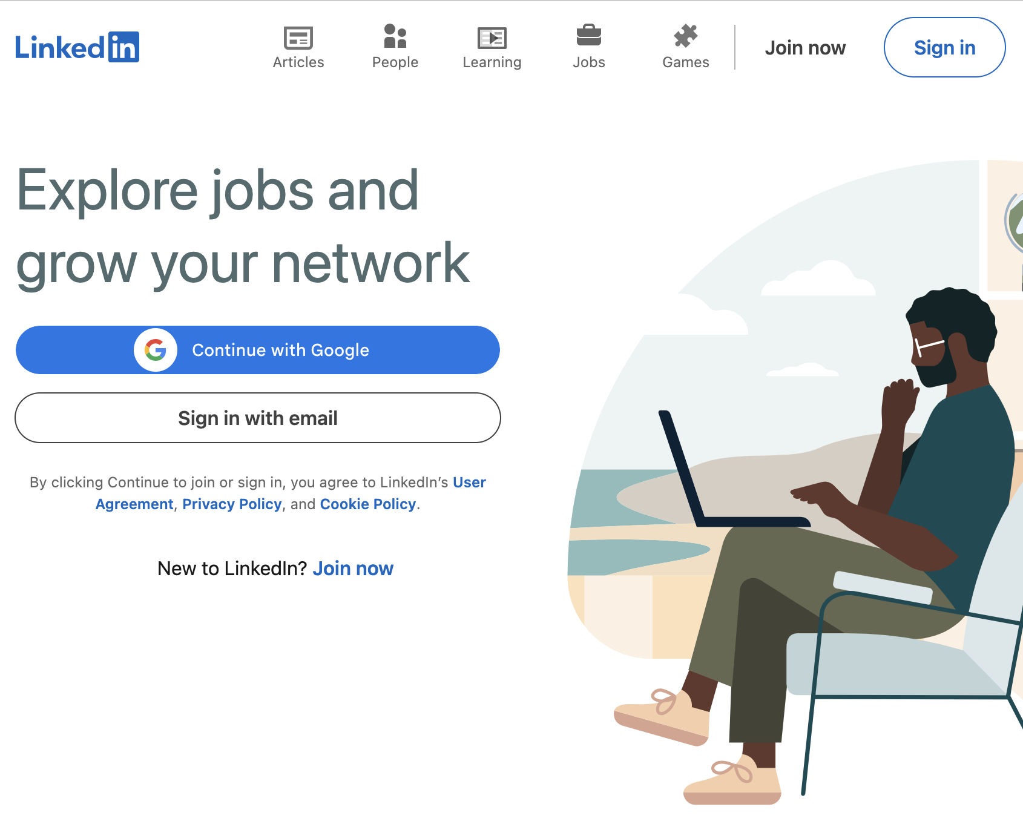
Getting Started with LinkedIn
Go to linkedin.com
Select Join now, or Sign in if you already have an account.
Follow prompts to set up your account and profile.
Remember to carefully select a profile photo that projects your intended image.

Slide 18
Artificial Intelligence

Slide 19
Discussion
What do you think AI is or what does it involve?
What have you heard about AI in the news?

Slide 20
What is it?

Slide 21
What is AI?

Slide 22
AI in Everyday Life

Slide 23
What is Generative AI?

Slide 24
Discussion
How did that video inform your thoughts about AI?

Slide 25
Best Practices When Prompting AI Agent
Do not share important details like account numbers, passwords, or other sensitive information.
Be nice! Research shows that AI Agents try harder when a user is nice.
The first response is often not the best response - work with the agent to iteratively refine the output.
Basic prompting formula:
Role – Tell the AI Agent what role to play (e.g., “You are a tech coach…”)
Context – Share key background info to help it understand your situation
Outcome – Clearly state what you want (a list? an email? an explanation?)
Ask for Help – Say: “Ask me questions if you need more info to help.”

Slide 26
Practice with Gemini
Choose from the following prompts or come up with your own:
Job Application Support “Can you help me start a cover letter for a medical receptionist position?”
Addressing a Technical Question “How do I adjust the brightness on my Chromebook?”
Government Services Information “How can I apply for SNAP (Supplemental Nutrition Assistance Program) benefits in Columbus, Ohio?”
Meal & Recipe Planning “Can you help me plan a simple low-cost holiday meal for 4 people?”
Pro Tip: If you’re unsure of how to structure your prompt ask the agent to help you build it!

Slide 27
BREAK

Slide 28
Final Showcase and Celebration

Slide 29
Post-Survey

Slide 30
A Few Of Our Favorite Things

Slide 31
Please Complete
https://tinyurl.com/DSH-Post-Survey

Slide 32
Miroboard
www.miro.com

Slide 33
Wrap-up

Slide 34
Wrap-Up
Questions from class
Turn in Devices

